Slide 1
Medical Therapy: Lipid Modifying Therapies
Schuyler Jones, MD
Associate Professor of Medicine
Duke University Health System
Durham, NC

Slide 2
Resource Information
About This Resource
These slides are one component of a continuing education program available online at MedEd On The Go titled Guidelines on the Management of Patients with PAD
Program Learning Objectives:
Demonstrate an understanding of the recent developments in PAD management
Apply the latest guideline-directed approaches for PAD management
MedEd On The Go®
www.mededonthego.com
This content or portions thereof may not be published, posted online or used in presentations without permission.
This content can be saved for personal use (non-commercial use only) with credit given to the resource authors.
To contact us regarding inaccuracies, omissions or permissions please email us at support@MedEdOTG.com

Slide 3
Disclaimer
The views and opinions expressed in this educational activity are those of the faculty and do not necessarily represent the views of Total CME, LLC, the CME providers, or the companies providing educational grants. This presentation is not intended to define an exclusive course of patient management; the participant should use their clinical judgment, knowledge, experience, and diagnostic skills in applying or adopting for professional use any of the information provided herein. Any procedures, medications, or other courses of diagnosis or treatment discussed or suggested in this activity should not be used by clinicians without evaluation of their patient's conditions and possible contraindications or dangers in use, review of any applicable manufacturer’s product information, and comparison with recommendations of other authorities. Links to other sites may be provided as additional sources of information.

Slide 4
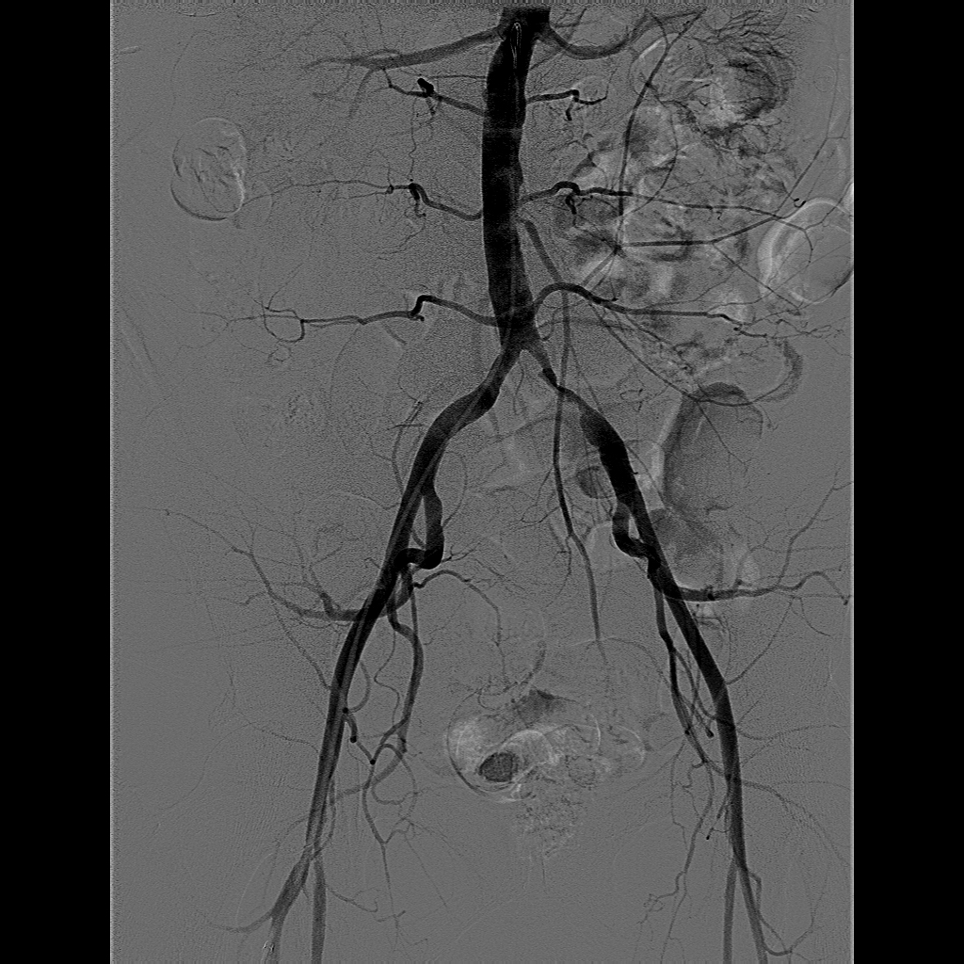
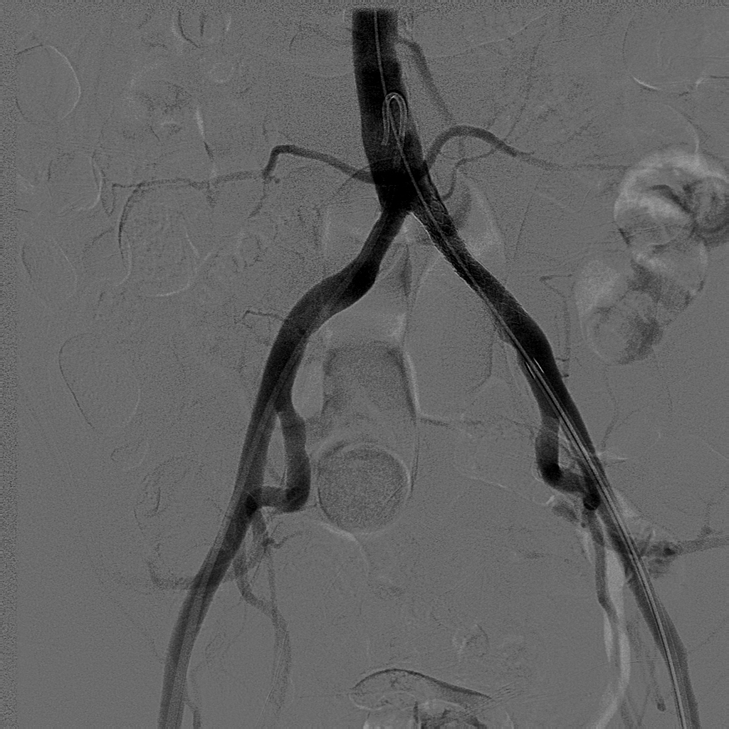
Treatment Framework for PAD
Pre
Post
Less
severe
DECISION REGARDING REVASCULARIZATION
Asymptomatic
Medical
Therapy
&
Exercise
Training
Surgery
Atypical leg pain
Intermittent
claudication
90% stenosis
Stent
Endovascular Revascularization
Critical limb ischemia
Ischemic rest pain
Tissue ulceration
Gangrene
DRUGS
Effect of antiplatelet and statin medication use
The range of statin use in PAD varies from 50 to 70% of overall patients
Outcomes
More
severe

Slide 5
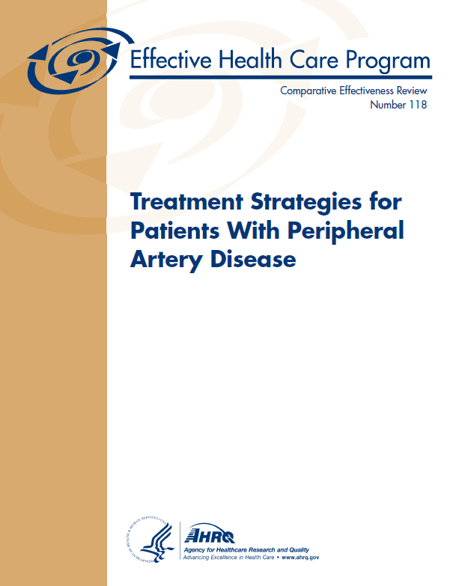
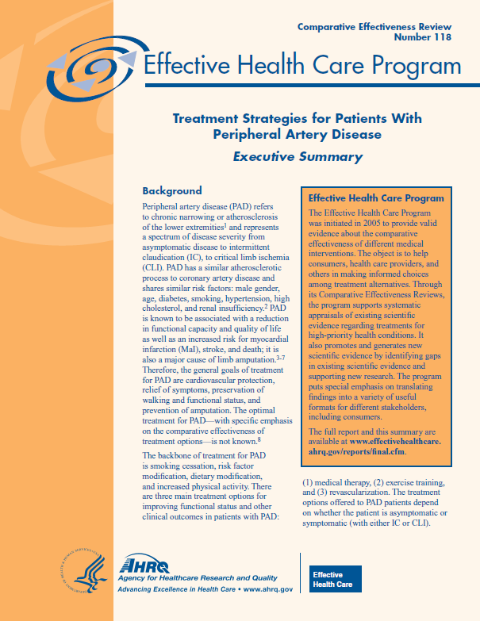
Treatment Strategies For Patients with Peripheral Artery Disease
U.S. Medicare Evidence Determination and Coverage Advisory Committee
Schuyler Jones, MD and Manesh Patel, MD
July 22, 2015

Slide 6
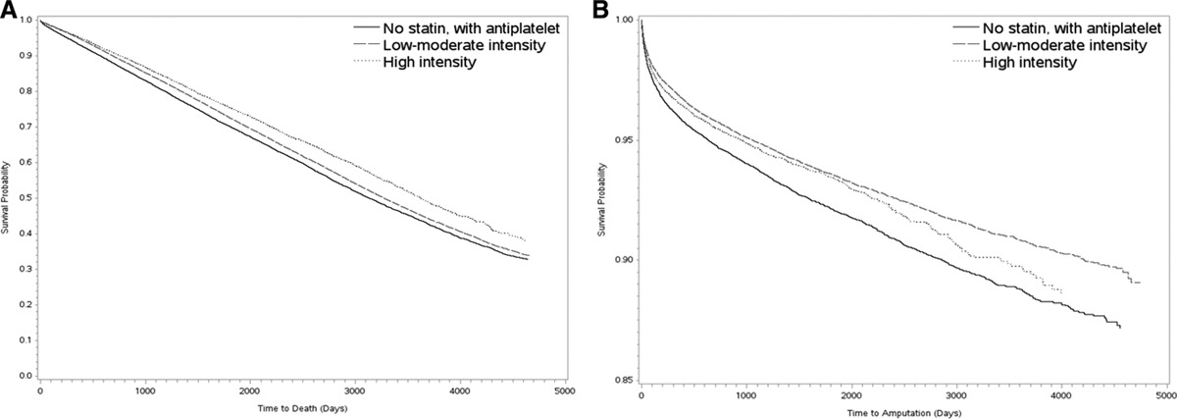
Statin Dose and Amputation-Free Survival

Slide 7
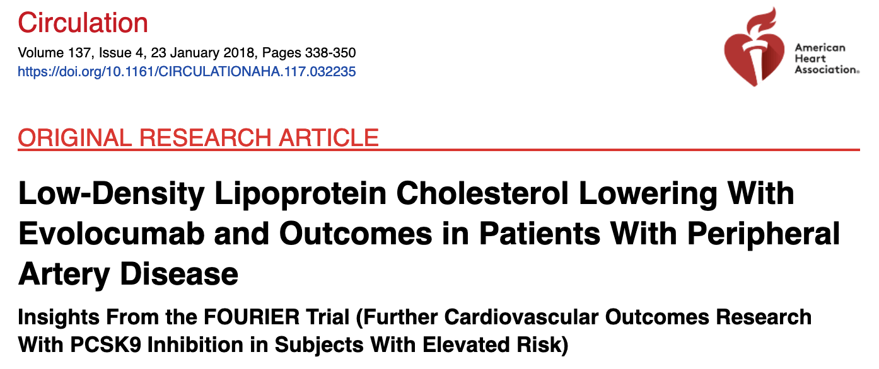
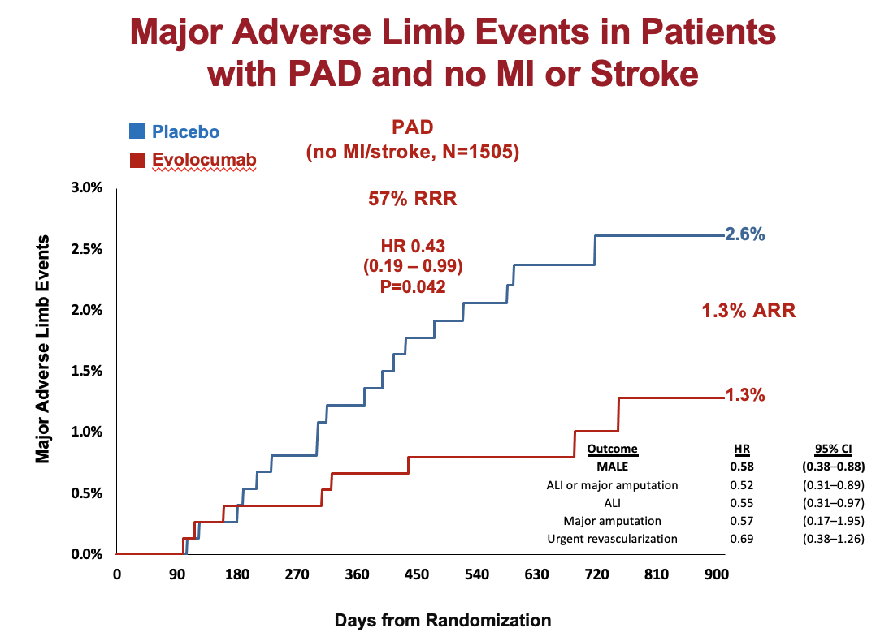

Slide 8
Cholesterol Guidelines
ACC/AHA Guidelines for PAD

Slide 9
Looking for more resources on this topic?
CME/CE in minutes
Congress highlights
Late-breaking data
Quizzes
Webinars
In-person events
Slides & resources
www.MedEdOTG.com

