Slide 1
Medical Therapy: New Horizons of Diabetes Therapies
Naomi Hamburg, MD, MS
Joseph Vita, Professor of Cardiovascular Medicine
Boston University Chobanian and Avedisian School of Medicine
Boston, MA

Slide 2



Resource Information
About This Resource
These slides are one component of a continuing education program available online at MedEd On The Go titled Guidelines on the Management of Patients with PAD
Program Learning Objectives:
Demonstrate an understanding of the recent developments in PAD management
Apply the latest guideline-directed approaches for PAD management
MedEd On The Go®
www.mededonthego.com
This content or portions thereof may not be published, posted online or used in presentations without permission.
This content can be saved for personal use (non-commercial use only) with credit given to the resource authors.
To contact us regarding inaccuracies, omissions or permissions please email us at support@MedEdOTG.com

Slide 3
Disclaimer
The views and opinions expressed in this educational activity are those of the faculty and do not necessarily represent the views of Total CME, LLC, the CME providers, or the companies providing educational grants. This presentation is not intended to define an exclusive course of patient management; the participant should use their clinical judgment, knowledge, experience, and diagnostic skills in applying or adopting for professional use any of the information provided herein. Any procedures, medications, or other courses of diagnosis or treatment discussed or suggested in this activity should not be used by clinicians without evaluation of their patient's conditions and possible contraindications or dangers in use, review of any applicable manufacturer’s product information, and comparison with recommendations of other authorities. Links to other sites may be provided as additional sources of information.

Slide 4
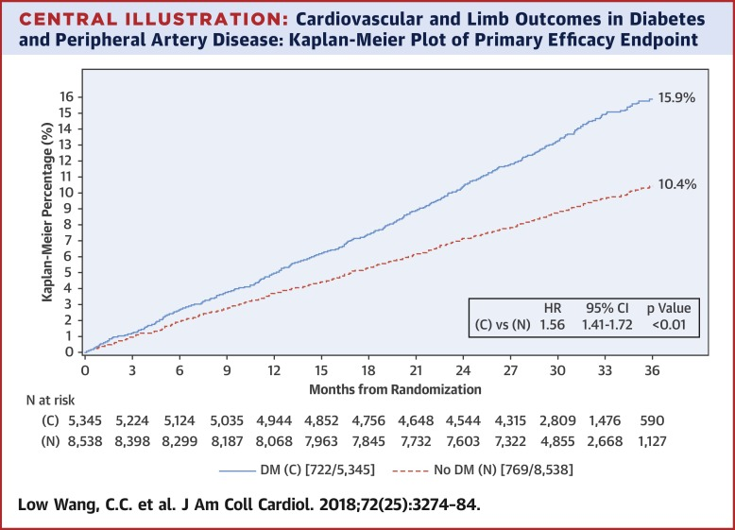
Patients with Diabetes and PAD at High Risk

Slide 5
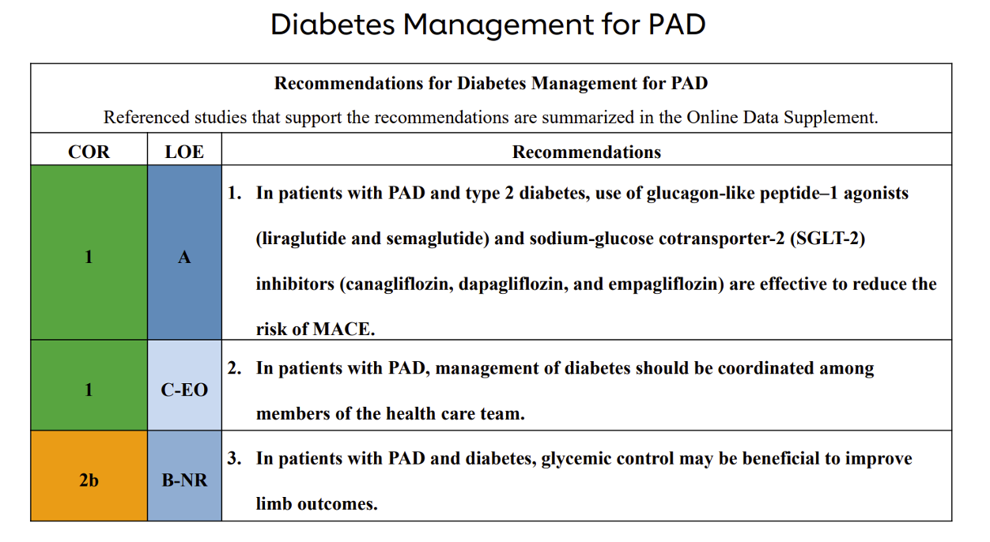
65-Year-Old Woman with T2DM, CAD, PAD and Leg Fatigue with Walking, on Metformin

Slide 6
Evidence for Newer Cardiometabolic
Therapies in PAD
GLP1 RA
SGLT2 Inhibitors
Liraglutide and semaglutide reduces MACE in T2DM including PAD
Liraglutide lowers amputation risk in subgroup
Semaglutide lowers MACE in obesity + ASCVD including PAD
Multiple agents reduce MACE including in T2DM and PAD
Meta-analysis of trials does not suggest increased risk of amputation
Reduce events in heart failure + PAD

Slide 7
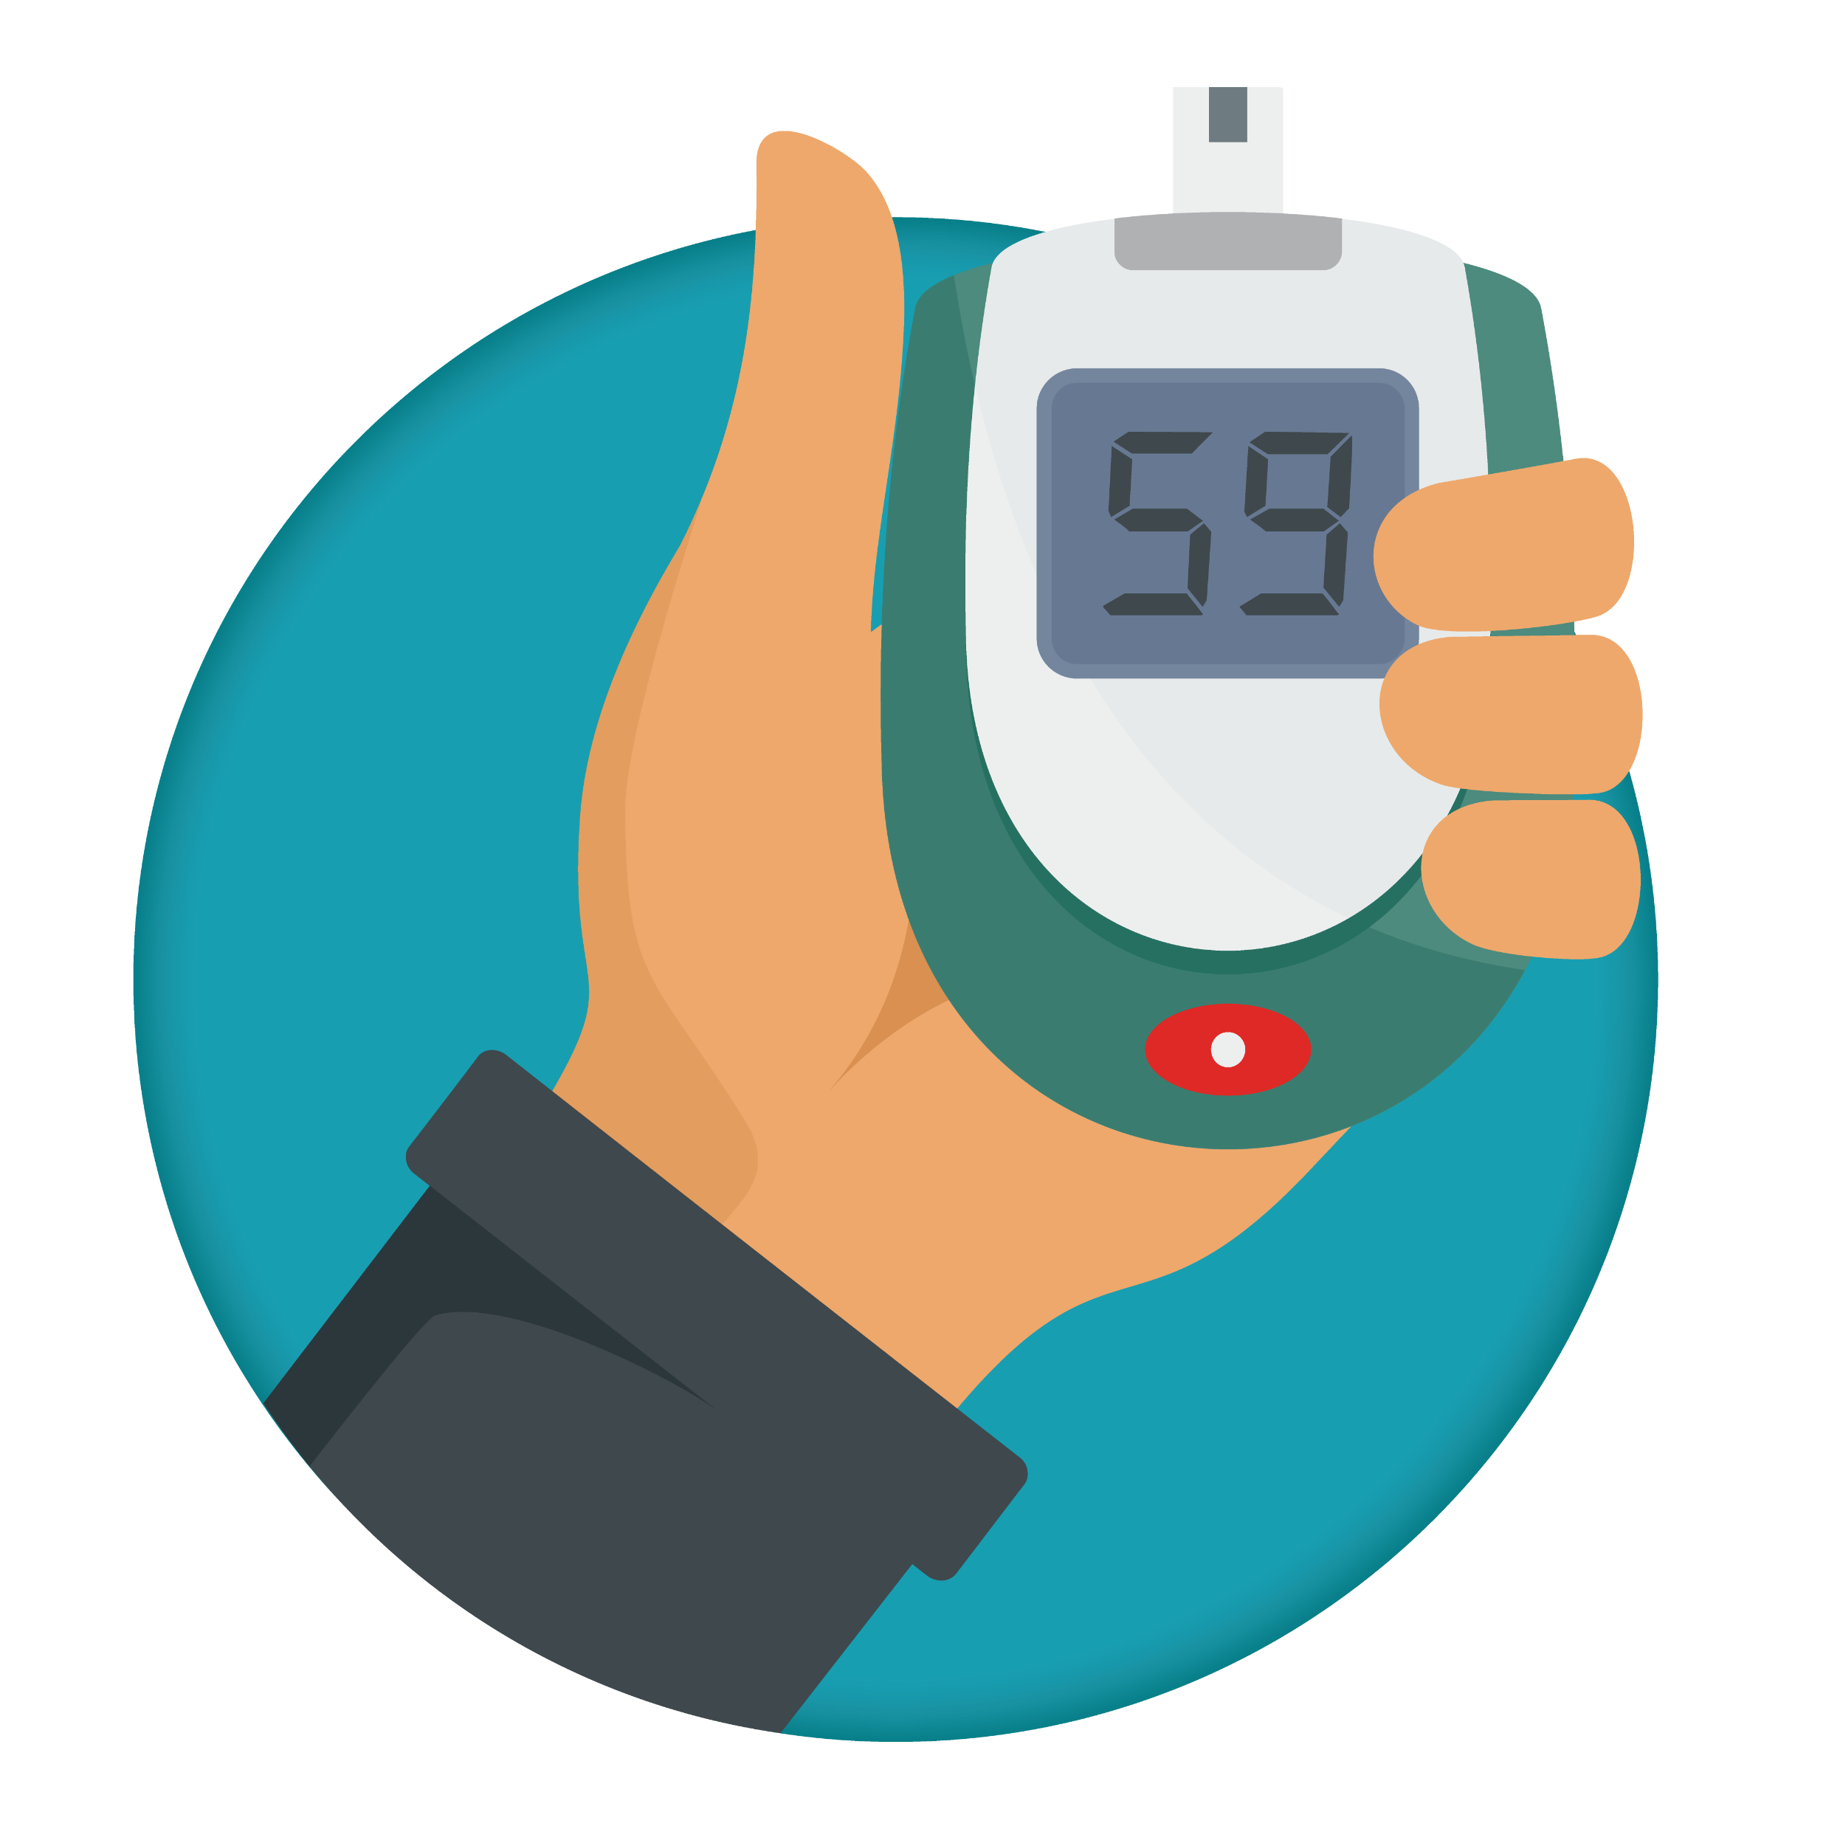
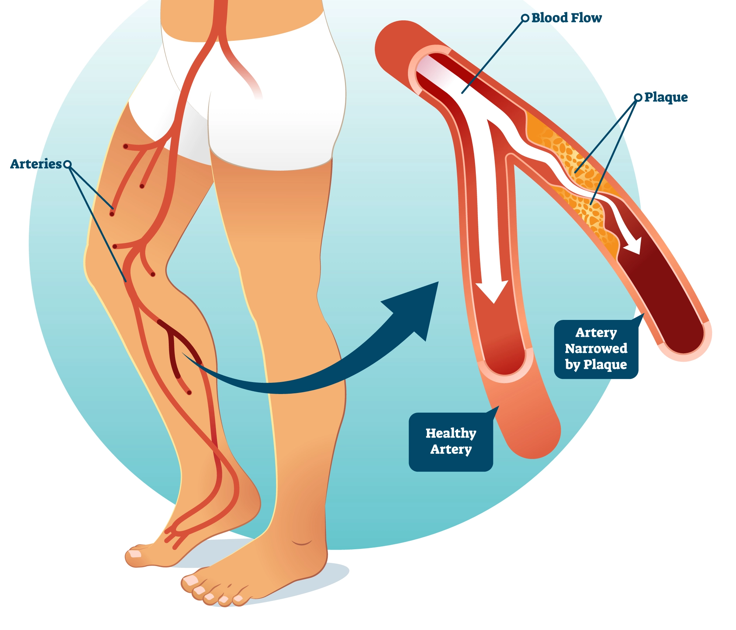
Beyond Glucose Lowering…
Diabetes Mellitus
Peripheral Artery Disease
Glucose
Atherosclerosis
Diabetes Mellitus

Slide 8



Looking for more resources
on this topic?
CME/CE in minutes
Congress highlights
Late-breaking data
Quizzes
Webinars
In-person events
Slides & resources
www.MedEdOTG.com

