Slide 1
D2 Antagonists Limitations and Challenges: A New Era in Schizophrenia Pathophysiology
Leslie Citrome, MD, MPH
Clinical Professor of Psychiatry and Behavioral Sciences
New York Medical College
Valhalla, NY

Slide 2
Resource Information
About This Resource
These slides are one component of a continuing education program available online at MedEd On The Go titled Schizophrenia: Evidence-based Approaches to Integrating Emerging Treatments Into Clinical Practice
Program Learning Objectives:
Identify the limitations of current D2 antipsychotic medications in treating SCZ, with a focus on efficacy limitations and safety/side effect considerations
Increase awareness in accurately identifying individuals who may benefit from switching to or augmentation with new and emerging therapies
Educate regarding how and when to incorporate switching or augmentation strategies into antipsychotic medication management of patients with SCZ, including special populations
Educate regarding the considerations of integrating new therapies into current clinical practice as a monotherapy, switching option, or augmentation strategy
Provide expert analysis of current clinical trial data of emerging treatment options, particularly regarding their efficacy in controlling negative and positive symptoms and cognitive function
MedEd On The Go®
www.mededonthego.com
This content or portions thereof may not be published, posted online or used in presentations without permission.
This content can be saved for personal use (non-commercial use only) with credit given to the resource authors.
To contact us regarding inaccuracies, omissions or permissions please email us at support@MedEdOTG.com

Slide 3
Disclaimer
The views and opinions expressed in this educational activity are those of the faculty and do not necessarily represent the views of Total CME, LLC, the CME providers, or the companies providing educational grants. This presentation is not intended to define an exclusive course of patient management; the participant should use their clinical judgment, knowledge, experience, and diagnostic skills in applying or adopting for professional use any of the information provided herein. Any procedures, medications, or other courses of diagnosis or treatment discussed or suggested in this activity should not be used by clinicians without evaluation of their patient's conditions and possible contraindications or dangers in use, review of any applicable manufacturer’s product information, and comparison with recommendations of other authorities. Links to other sites may be provided as additional sources of information.

Slide 4
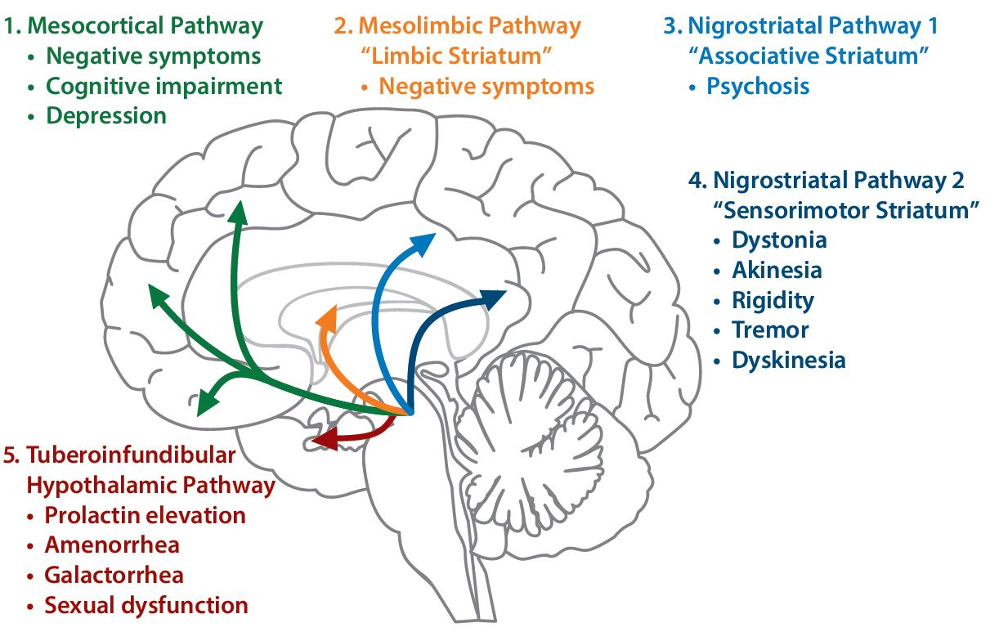
Schizophrenia: Dopamine Pathways in the Human Brain
1. Mesocortical pathway: originates from the VTA in the midbrain and innervates areas of the frontal cortex
2. Mesolimbic pathway: originates from the VTA in the midbrain and innervates the ventral striatum, olfactory tubercle, and parts of the limbic system
3. Nigrostriatal pathway 1: originates in the substantia nigra and innervates the associative striatum
4. Nigrostriatal pathway 2: originates in the substantia nigra and innervates the sensorimotor striatum
5. Tuberoinfundibular hypothalamic pathway: projects from the hypothalamus to the anterior pituitary gland

Slide 5
Currently Available Antipsychotics Block Dopamine D2 Receptors: There Are Many Limitations to This Approach
Residual Symptoms and Inadequate Treatment Response
1 out of every 3 patients do not respond¹⁻³
Negative and cognitive symptoms may persist¹

Slide 6
Currently Available Antipsychotics Block Dopamine D2 Receptors: There Are Many Limitations to This Approach
Residual Symptoms and Inadequate Treatment Response
1 out of every 3 patients do not respond¹⁻³
Negative and cognitive symptoms may persist¹
Varying levels of side effects and long-term risks¹ ​may contribute to negative outcomes and poor adherence⁴
First generation APs: generally associated with movement disorders and prolactin elevation⁵⁻⁷
Second generation APs: typically associated with sedation, weight gain, and metabolic dysregulation⁵⁻⁷

Slide 7
Frequency of Antipsychotic Side Effects in Schizophrenia Patients
2007-2008 Survey of Medication Side Effects* in Community-dwelling Adults with Schizophrenia
Pre-specified definition of side effect included any side effect to which a patient was “somewhat, very, or extremely bothered.”
Orange bars represent D₂ antagonism-related AEs.
% Reporting Bothersome Side Effects

Slide 8
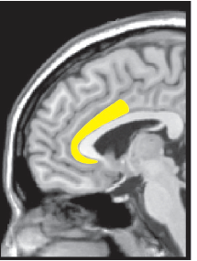
What About Schizophrenia Patients Who Do Not Respond to D2 Modulation?
Treatment-resistant schizophrenia occurs in a large subgroup of patients (34%)¹; these patients do not adequately respond to D2 modulation¹
Cross-sectional neuroimaging studies suggest that a poor response to APs is associated with relatively normal striatal DA synthesis capacity but elevated anterior cingulate cortex (ACC) and striatal glutamate levels^{2,3}
The ACC is “affective”: involved in emotion assessment, emotion-related learning, and autonomic regulation, with widespread projections to other areas of the brain that are important for emotion (e.g. amygdala), memory (e.g. hippocampal region), and reward (e.g. orbitofrontal cortex, ventral striatum)⁴
Adapted from Stevens et al 2011.
Adapted from Stevens et al 2011.

Slide 9
The Glutamate Hypofunction Hypothesis of Schizophrenia¹⁻²
Psychosis in schizophrenia may be the result of hypofunctional NMDA receptors on GABA interneurons in the cerebral cortex
This hypofunction may lead to overactivation of downstream glutamate signaling
Overactivation of this pathway may result in turn in excess dopamine resulting in psychosis
Glutamate pathways in the brain. BioRender.com.

Slide 10
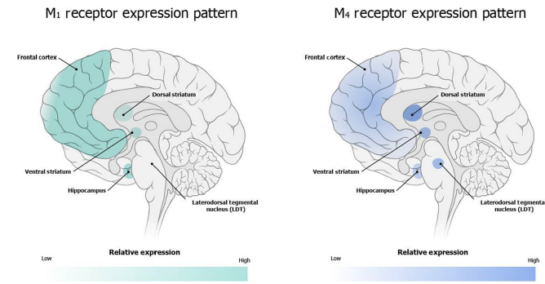
Muscarinic Cholinergic Hypothesis of Schizophrenia
In the 1950s, pro-cholinergic drugs were observed to increase “lucid intervals” in patients with psychosis,¹ but were not well tolerated, and further development was abandoned, until now
Cholinergic systems directly modulate striatal DA function in areas associated with positive symptoms of schizophrenia and also regulate descending Glu pathways that interact with striatal DA circuits²
M1/M4 receptor mouse knockout models replicate the phenotype of schizophrenia,³ and muscarinic agonists, especially for M4, improve positive and negative symptoms of schizophrenia in mice and humans⁴
Yohn et al 2022.
Postmortem studies^{2,5,6} show reductions in M1 and M4 receptor expression in brain regions implicated in schizophrenia
25% of patients have ≥75% reduction in M1 receptor expression

Slide 11
The Search for a “Non-D2” Mechanism Continues
There has been substantial investment in the research and development of non-D2 drug candidates for schizophrenia, however, none have been approved by any regulatory authority
Of 545 clinical trials from 2002 - 2022, total patient enrollments for non-D2 compounds (~34,000 patients) surpassed that of D2-based compounds (~27,000 patients)
Industry-Sponsored Phase 2/3 Schizophrenia Studies
N=545
Studies of Novel Investigational Treatments
N=203
D2
32%
Novel investigational treatment
Non-D2
68%
No launches

Slide 12
Investigational “Non-D2” Compounds for Schizophrenia
Substantial ongoing investments in novel non-D2 options for schizophrenia remain1-4
Improved trial design, conduct, endpoints, and analyses/methods may influence signal detection and reliability to support development and registration of non-D2 compounds
Generic Name | Proposed MOA in Schizophrenia | Status
Emraclidine | Highly Selective Positive Allosteric Modulator (PAM) of M4 Muscarinic Acetylcholine Receptors | Phase 2¹
KarXT (xanomeline-trospium) | M1/M4-preferring muscarinic agonist | Phase 3²
Ulotaront (SEP-363856) | TAAR1 agonist with 5-HT_{1A} agonist activity | Phase 3³
NOTE: not inclusive of all compounds in development

Slide 13
Looking for more resources on this topic?
CME/CE in minutes
Congress highlights
Late-breaking data
Quizzes
Webinars
In-person events
Slides & resources
www.MedEdOTG.com

