Slide 1
Exploring the Spectrum of Efficacy in Emerging Schizophrenia Therapies:
From Positive to Negative to Cognitive Symptoms
Christoph U. Correll, MD
Professor of Psychiatry and Molecular Medicine
The Donald and Barbara Zucker School of Medicine at Hofstra/Northwell
Hempstead, NY

Slide 2



Resource Information
About This Resource
These slides are one component of a continuing education program available online at MedEd On The Go titled Schizophrenia: Evidence-based Approaches to Integrating Emerging Treatments Into Clinical Practice
Program Learning Objectives:
Identify the limitations of current D2 antipsychotic medications in treating SCZ, with a focus on efficacy limitations and safety/side effect considerations
Increase awareness in accurately identifying individuals who may benefit from switching to or augmentation with new and emerging therapies
Educate regarding how and when to incorporate switching or augmentation strategies into antipsychotic medication management of patients with SCZ, including special populations
Educate regarding the considerations of integrating new therapies into current clinical practice as a monotherapy, switching option, or augmentation strategy
Provide expert analysis of current clinical trial data of emerging treatment options, particularly regarding their efficacy in controlling negative and positive symptoms and cognitive function
MedEd On The Go®
www.mededonthego.com
This content or portions thereof may not be published, posted online or used in presentations without permission.
This content can be saved for personal use (non-commercial use only) with credit given to the resource authors.
To contact us regarding inaccuracies, omissions or permissions please email us at support@MedEdOTG.com

Slide 3
Disclaimer
The views and opinions expressed in this educational activity are those of the faculty and do not necessarily represent the views of Total CME, LLC, the CME providers, or the companies providing educational grants. This presentation is not intended to define an exclusive course of patient management; the participant should use their clinical judgment, knowledge, experience, and diagnostic skills in applying or adopting for professional use any of the information provided herein. Any procedures, medications, or other courses of diagnosis or treatment discussed or suggested in this activity should not be used by clinicians without evaluation of their patient's conditions and possible contraindications or dangers in use, review of any applicable manufacturer’s product information, and comparison with recommendations of other authorities. Links to other sites may be provided as additional sources of information.

Slide 4
Overview
Emerging Treatments for the Spectrum in Schizophrenia
  Total and Positive Symptoms
  Negative Symptoms
  Cognitive Symptoms
Summary and Conclusions

Slide 5
Emerging Agents with
Novel Mechanism of Action

Slide 6
Novel MOA Antipsychotics in Development
Ulotaront
(SEP-363856)¹
Xanomeline+
Trospium
(KarXT)²
Emraclidine
(CVL-231)³
TAAR1 agonist
5-HT_{1A} agonist
No D₂ binding
M₁/M₄ agonist
No D₂ binding
Peripheral muscarinic antagonist
M₄-positive allosteric
modulator
No D₂ binding
Pimavanserin⁴
Roluperidone⁵
5-HT_{2A} inverse agonist/antagonist
No D₂ binding
5-HT_{2A} antagonist / Sigma 2 antagonist
No D₂ binding
Iclepertin⁶
Glycine transporter 1 inhibitor

Slide 7
Total, Positive and
Negative Symptoms

Slide 8
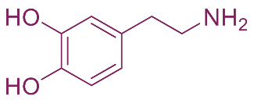
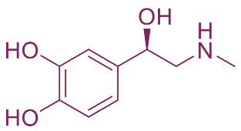
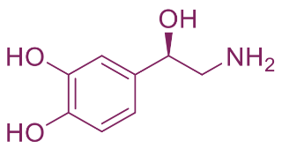
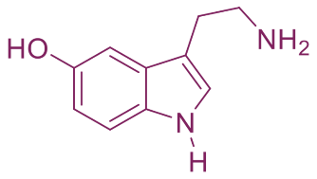
What Are Trace Amines and Trace Amine
Associated Receptors?
Trace amines (TAs):¹⁻⁴
  Endogenous chemical messengers, referred to as ”false neurotransmitters” because they are not released from synaptic vesicles when the neuron fires
    Serve as true neurotransmitters in invertebrates
  Structurally similar to monoamine neurotransmitters, eg, dopamine, norepinephrine, serotonin
    Expressed at levels at least 100-fold lower than corresponding neurotransmitters²
    Present in food (significant amounts in seafood, cured meats, wine, cheese, and chocolate)
    Produced by human microbiota
Trace amine-associated receptors (TAARs):¹
  In 2001, TAs were found to selectively activate a family of receptors called TAARs that are located in the CNS and periphery.¹
    TAARs are predominantly intracellular receptors that modulate neurotransmission of dopamine, serotonin and glutamate.
    Most studied is TAAR1
Traditional TAs
Monoamine Neurotransmitters
β-Phenethylamine
Dopamine
p-Octopamine
Epinephrine
p-Synephrine
Norepinephrine
Tryptamine
Serotonin
p-Tyramine
Adapted from Dedic N, et al.

Slide 9
Investigational TAAR1 Compounds in Clinical Trials
Two investigational TAAR1 compounds reached Phase 2/3 clinical trials for the treatment of schizophrenia and other psychiatric conditions
Each have different receptor pharmacology^{1,2}:
Ralmitaront*: TAAR1 partial agonist
  2 recently-terminated Phase 2 trials in schizophrenia and schizoaffective disorder (acute exacerbation, and augmentation for negative symptoms)³
Ulotaront: TAAR1 agonist with 5-HT_{1A} agonist activity
  Positive phase 2 study in schizophrenia^{4,5}; 2 negative phase 3 studies⁶
  adjunctive MDD and GAD clinical trials ongoing⁶

Slide 10
Ulotaront Phase 3 DIAMOND 1 and 2 Trials:
Top Line Results
DIAMOND 1 study: multicenter, randomized, double-blind, parallel-group, fixed-dosed trial comparing ulotaront 50 mg/d and 75 mg/d versus placebo over 6 weeks in 435 acutely psychotic adults with schizophrenia.
All three groups showed a reduction in the Positive and Negative Syndrome Scale (PANSS) total score over time, without either ulotaront treatment group being superior to placebo on PANSS total change at Week 6 (least squares [LS] mean:
  ulotaront 50 mg/day: -16.9; ulotaront 75 mg/day: -19.6; placebo: -19.3 points
DIAMOND 2 study: multicenter, randomized, double-blind, parallel-group, fixed-dosed trial comparing ulotaront 75 mg/d and 100 mg/d versus placebo over 6 weeks in 464 acutely psychotic adults with schizophrenia
All three groups showed a reduction in PANSS total score over time, without either ulotaront treatment group being superior to placebo on PANSS total change at Week 6 (least squares [LS] mean:
  ulotaront 75 mg/day: -16.4; ulotaront 100 mg/day: -18.1; placebo: -14.3 points
Ulotaront was generally safe and well-tolerated in both studies

Slide 11
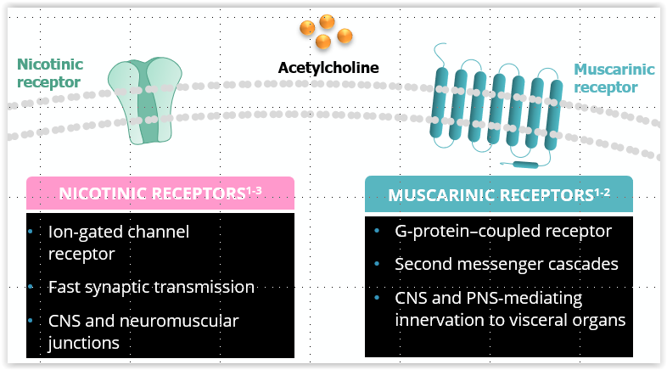
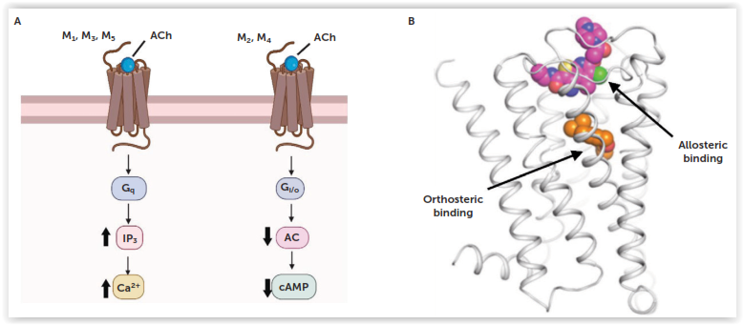
The Nicotinic Versus Muscarinic Cholinergic Receptor System
Signaling Selectivity Among Muscarinic Acetylcholine M1-M5 Receptors
Postsynaptic
Receptor
Presynaptic
Autoreceptor
Stimulatory
Inhibitory

Slide 12
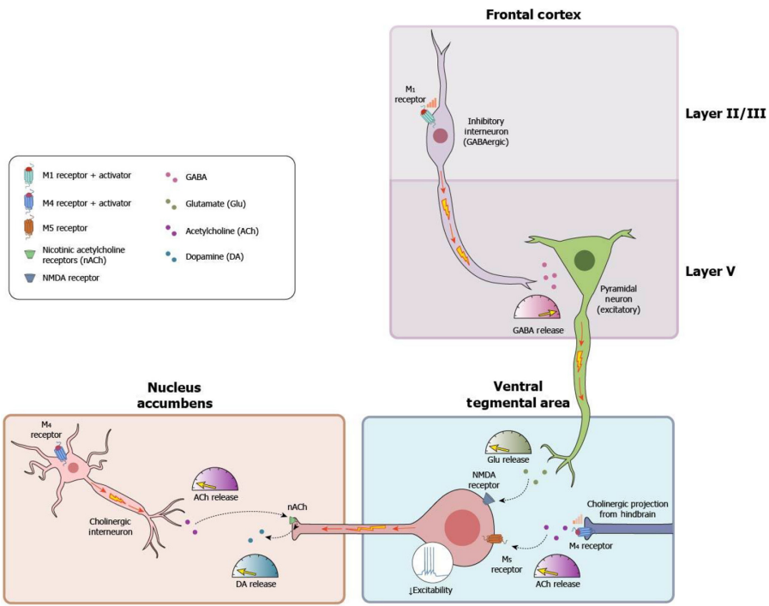
Regulation of Dopamine Circuits Relevant in Psychosis by M1 & M4 Receptors

Slide 13
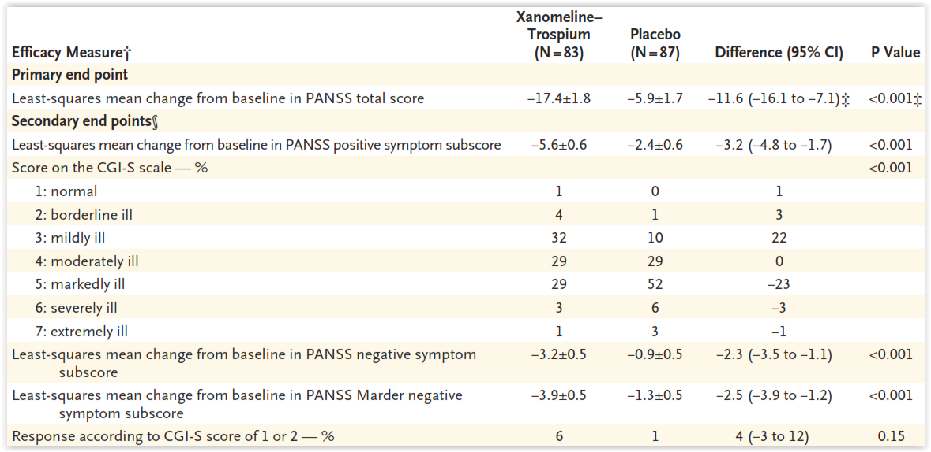
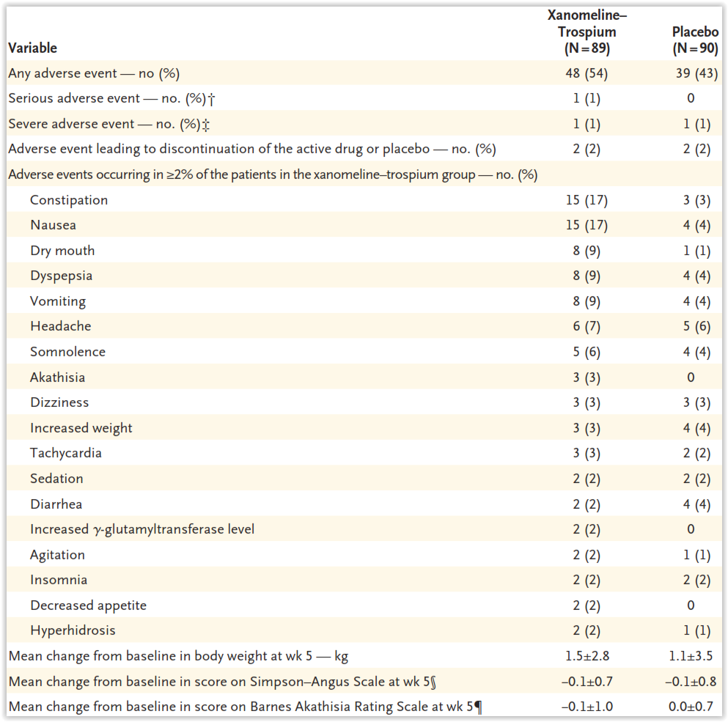
Xanomeline + Trospium Chloride Phase 2B Study:
Primary and Secondary Endpoint Analyses (mITT) + Safety Analyses
ES=0.75 (recalculated: 0.81)

Slide 14
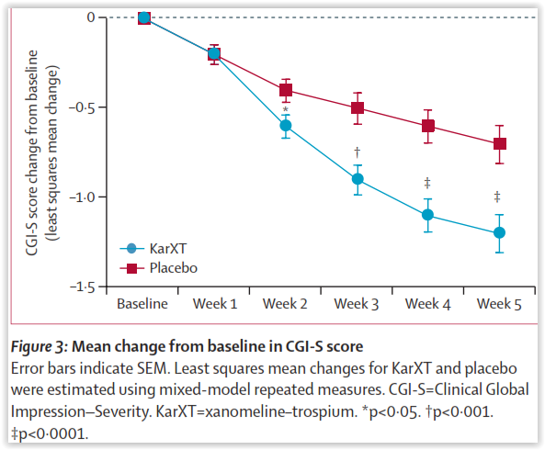
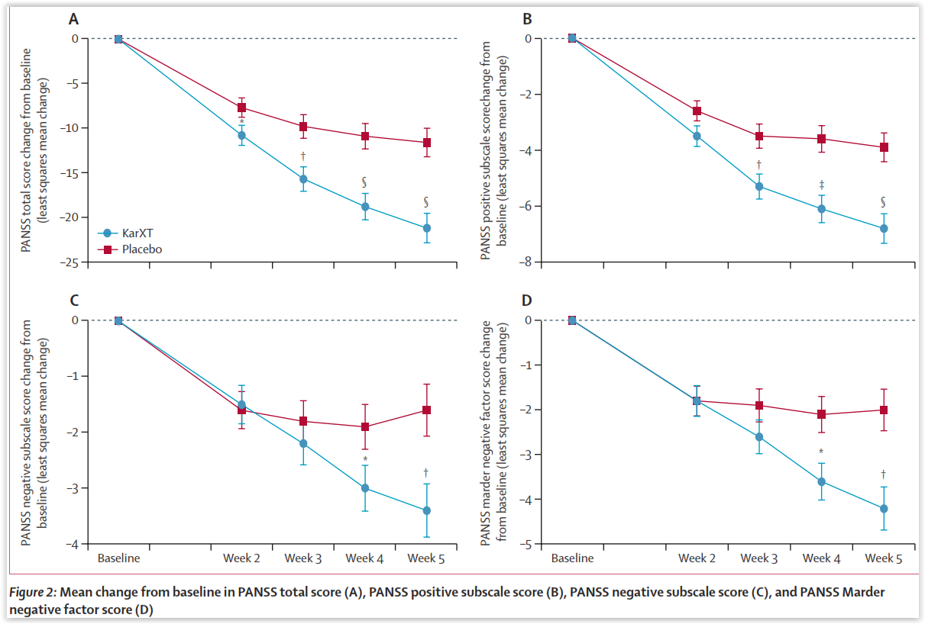
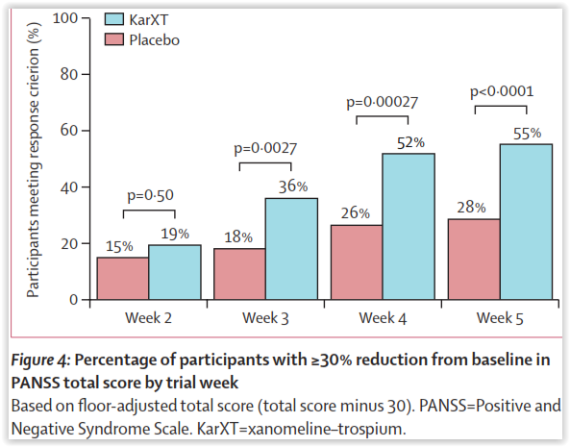
KarXT Phase 3 EMERGENT-2 Trial:
Change in PANSS total and subscale scores, CGI-S and Response Rates from Baseline to Week 5
CGI-S
PANSS-Total
PANSS-Positive
ES: 0.61
Response
PANSS-Negative
PANSS-Marder Negative
NNT=4
NNT=4
CGI-S
NNT=6

Slide 15
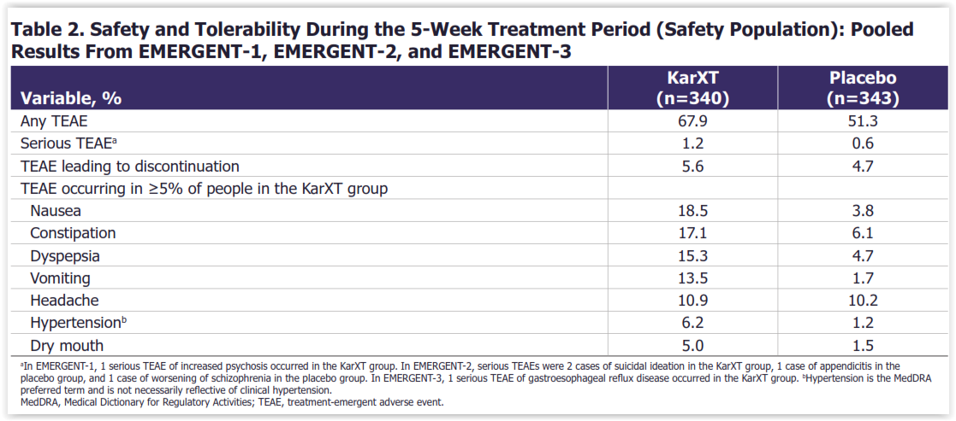
KarXT Phase EMERGENT-1, EMERGENT-2 and EMERGENT-3: Treatment Emergent Adverse Effects from Baseline to Week 5

Slide 16
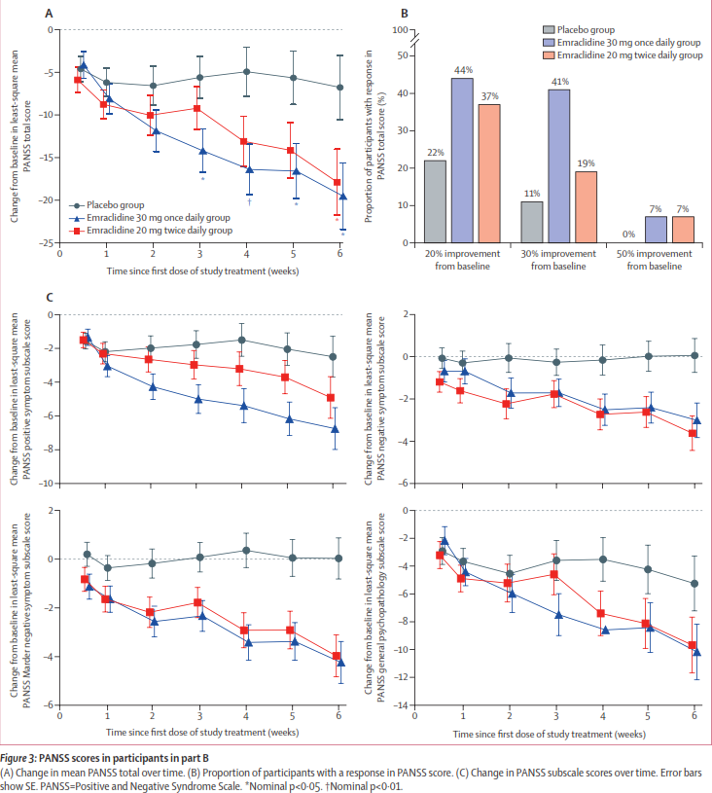
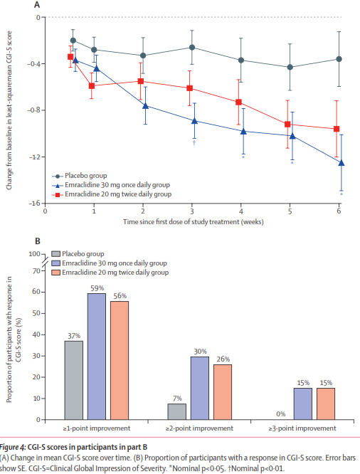
M4 Positive Allosteric Modulator Emraclidine Phase 1B Study:
Efficacy Results in Change from Baseline to Week 6
PANSS-Total
Response
NNT=5
NNT=3
ES=0.59
NNT=15
CGI-S Change
ES=0.68
PANSS-Positive
PANSS-Negative
NNT=5
CGI-S Point Change
PANSS-Marder Negative
PANSS-General
NNT=5
NNT=7

Slide 17
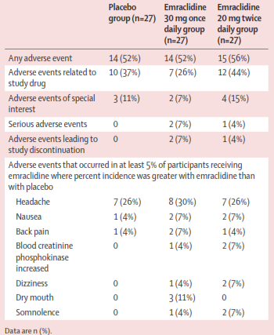
M4 Positive Allosteric Modulator Emraclidine :
Adverse Effect Results in Part B of a Phase 1B Study

Slide 18
Negative Symptoms

Slide 19
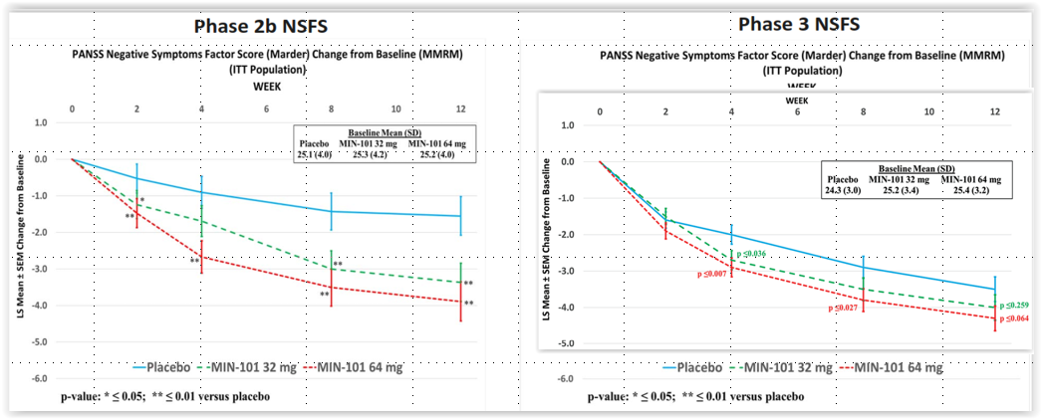
5-HT_{2A}/Sigma 2 Receptor Antagonist Roluperidone:
PHASE 2B Versus PHASE 3 Trial Results:
Change in PANSS Marder Negative Symptom Factor Score

Slide 20
Cognitive Symptoms

Slide 21
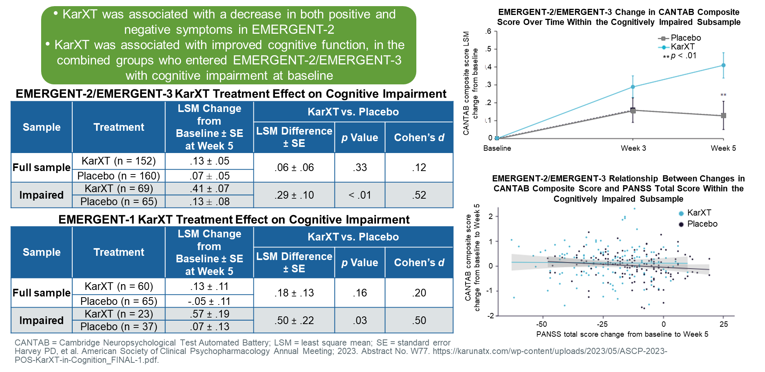
KarXT EMERGENT-1 and EMERGENT-2 and EMERGENT-3: Change in Cognition From Baseline to Week 5

Slide 22
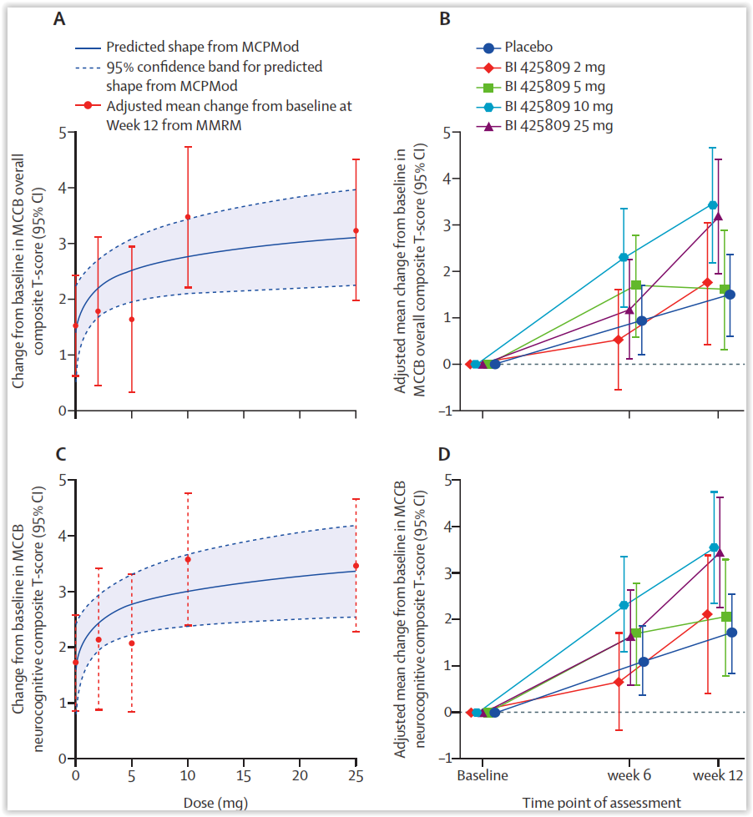
Adjunctive BI 425809, a Novel Glycine Transporter Inhibitor, for Cognitive Dysfunction
Better response in full dataset:
one concurrent antipsychotic,
more negative symptoms
not receiving concurrent benzodiazepines
Better response to 10 mg BI425809:
aged 38 years or younger
females
baseline MCCB overall composite
T-score <40
schizophrenia duration of 5–10 years

Slide 23
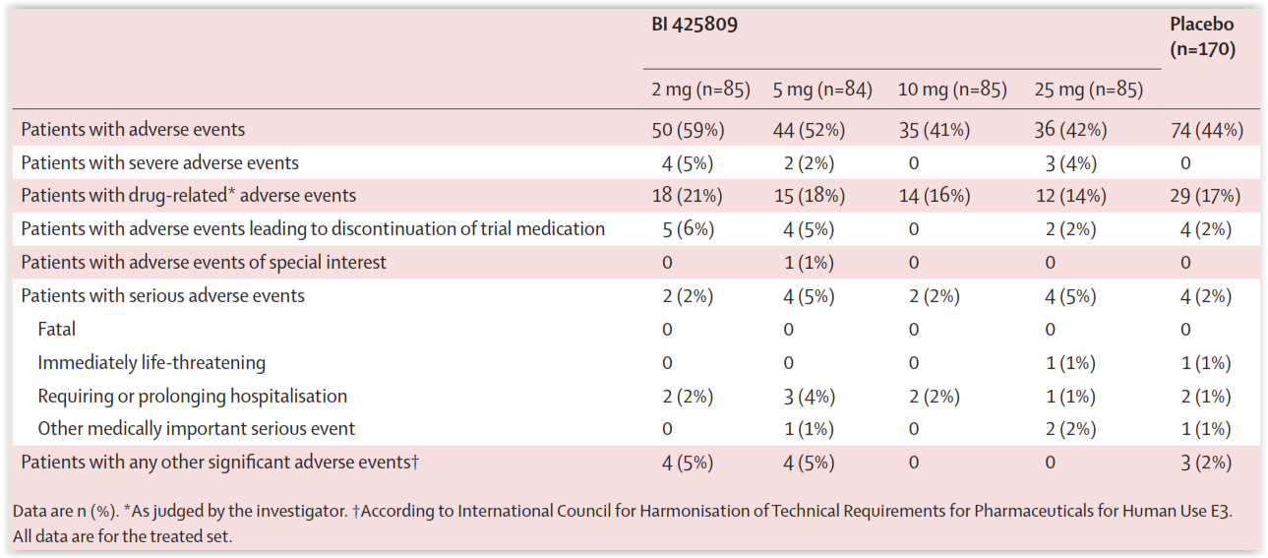
Adjunctive BI 425809 for Cognitive Dysfunction: Adverse Effects

Slide 24
Summary and Conclusions
After 7 decades of the primacy of dopamine receptor blockade, the field is finally seeing alternative treatment options for schizophrenia emerge
Encouraging Phase 1b, 2, 3 results for:
  M1/M4 agonist xanomeline + trospium chloride for total psychotic symptoms (3 positive trials) and cognition
  M4 positive allosteric modulator emraclidine for total psychotic symptoms (1 positive phase 1B trial, 2 ongoing phase 2 trials)
  TAAR1 agonist ulotaront for total psychotic symptoms (1 positive phase 2 trial, 2 negative phase 3 trials)
  Pimavanserin for negative symptoms (1 positive phase 2 trial, 1 negative phase 3 trial)
  Roluperidone for negative symptoms (1 positive phase 2 trial, 1 negative phase 3 trial)
  Adjunctive iclepertin for cognitive dysfunction (1 positive phase 2 trial, 2 ongoing phase 3 trials)
Novel mechanism action drugs for schizophrenia and its different domains remain an
urgent needed
The transferability of clinical trial data into the real world and potential superiority of novel mechanisms of action agents for specific subtypes of patients require further study

Slide 25



Looking for more resources
on this topic?
CME/CE in minutes
Congress highlights
Late-breaking data
Quizzes
Webinars
In-person events
Slides & resources
www.MedEdOTG.com

