Slide 1
From Trial to Treatment: Translating Emerging Clinical Data into Meaningful Schizophrenia Clinical Care
Christoph U. Correll, MD
Professor of Psychiatry and Molecular Medicine
The Donald and Barbara Zucker School of Medicine at Hofstra/Northwell
Hempstead, NY

Slide 2
Resource Information
About This Resource
These slides are one component of a continuing education program available online at MedEd On The Go titled Schizophrenia: Evidence-based Approaches to Integrating Emerging Treatments Into Clinical Practice
Program Learning Objectives:
Identify the limitations of current D2 antipsychotic medications in treating SCZ, with a focus on efficacy limitations and safety/side effect considerations
Increase awareness in accurately identifying individuals who may benefit from switching to or augmentation with new and emerging therapies
Educate regarding how and when to incorporate switching or augmentation strategies into antipsychotic medication management of patients with SCZ, including special populations
Educate regarding the considerations of integrating new therapies into current clinical practice as a monotherapy, switching option, or augmentation strategy
Provide expert analysis of current clinical trial data of emerging treatment options, particularly regarding their efficacy in controlling negative and positive symptoms and cognitive function
MedEd On The Go®
www.mededonthego.com
This content or portions thereof may not be published, posted online or used in presentations without permission.
This content can be saved for personal use (non-commercial use only) with credit given to the resource authors.
To contact us regarding inaccuracies, omissions or permissions please email us at support@MedEdOTG.com

Slide 3
Disclaimer
The views and opinions expressed in this educational activity are those of the faculty and do not necessarily represent the views of Total CME, LLC, the CME providers, or the companies providing educational grants. This presentation is not intended to define an exclusive course of patient management; the participant should use their clinical judgment, knowledge, experience, and diagnostic skills in applying or adopting for professional use any of the information provided herein. Any procedures, medications, or other courses of diagnosis or treatment discussed or suggested in this activity should not be used by clinicians without evaluation of their patient's conditions and possible contraindications or dangers in use, review of any applicable manufacturer’s product information, and comparison with recommendations of other authorities. Links to other sites may be provided as additional sources of information.

Slide 4
Overview
Unmet Needs in Schizophrenia
Goal Setting, Functioning and Life Engagement
Role and Position of Emerging Treatments for Schizophrenia

Slide 5
Clinical Domains of Schizophrenia Requiring Attention
Cardiometabolic burden^{7,8}
Addiction^{9,10}
Positive symptoms¹
Negative symptoms²
Hallucinations
Delusions
Thought disorder
Hostility/Excitability
Anosognosia
Relapse prevention
Affective flattening
Alogia
Anhedonia
Amotivation
Asociality
Health & Functioning
Motor symptoms³
Cognitive dysfunction⁴
Motor delay
Dyscoordination
EPS, e.g.,
Parkinsonism
Dyskinesia
Attention
Working memory
Verbal memory
Visual memory
Executive functioning
Processing speed
Social conditioning
Affective symptoms⁵
Depression
Anxiety
Suicidality

Slide 6
Physicians Focus Is Mainly on Symptom Improvement
Most common reasons for physicians to select an antipsychotic
n=872 European and US physicians
Percentage of patients (n=6,523)
Notes:
Lecrubier (A) Pg. 378
Lecrubier (B) Pg. 373

Slide 7
Patients Focus Is Also a Lot on Tolerability
77%
Reported medication side effects
30%
Reported impairment in their daily life as a result of medication side effects
61%
Reported moderate or severe impairment in their daily life as a result of medication side effects
In a study of 1,825 participants with psychosis:
Side effects – disabling; markedly affect quality of life.
If not addressed early, side effects can cause long-term distress and contribute
to chronic health complications.
Notes:
Morgan (B) Pg. 742
Morgan (A) Pg. 738

Slide 8
The Effectiveness Pyramid
Medication
Functional Capacity
Quality of Life
Subjective Well-being
Psycho- Education
Psycho- Therapy
Adherence/Alliance
Tolerability
Efficacy

Slide 9
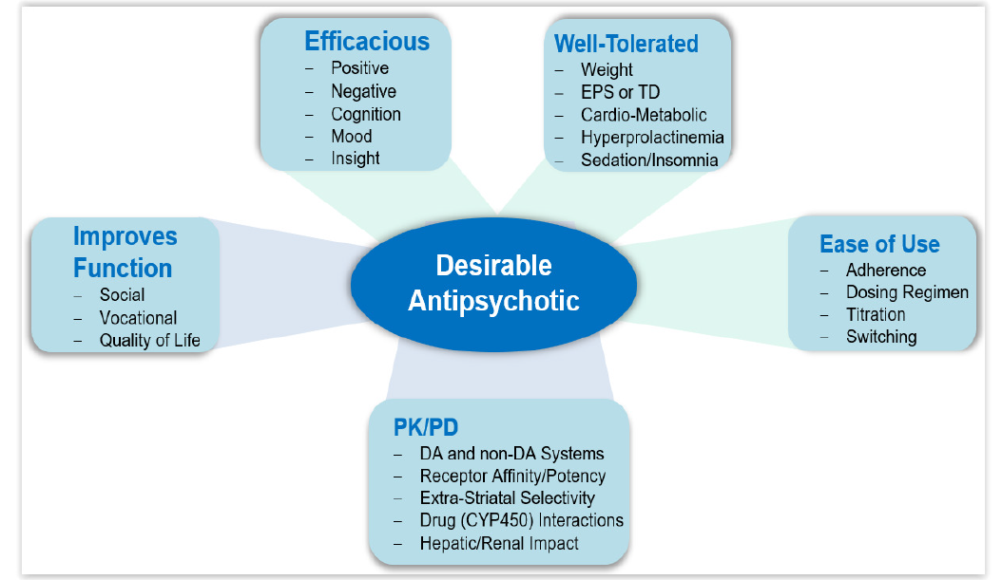
What Are the Desirable Characteristics of an “Idea” Anti-“Psychotic”?
DA, dopaminergic; PD, pharmacodynamic; PK, pharmacokinetic; TD, tardive dyskinesia.
Correll CU. J Clin Psychiatry. 2011;72(suppl 1):9-13.

Slide 10
Overview
Unmet Needs in Schizophrenia
Goal Setting, Functioning and Life Engagement
Role and Position of Emerging Treatments for Schizophrenia

Slide 12
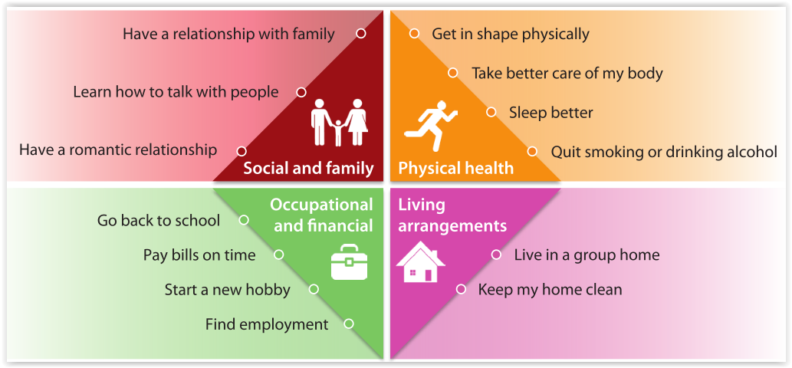
Life Engagement as a Meaningful Goal

Slide 13
Collaborative Care: Planning
During the planning process, several important functions are performed:
Setting priorities and goals
Appraising strengths
Selecting appropriate interventions
Determining resources
Everyone works together to:
Clarify personal choices
Identify environmental options
Clarify personal values
Identify personal interests

Slide 14
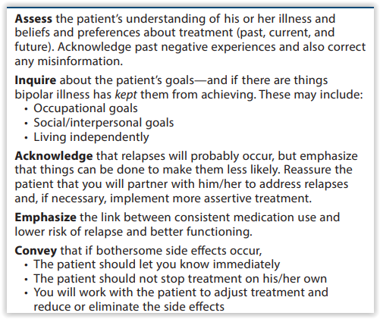
Key Points for Patient-Centric Discussions of Treatment Goals and Options

Slide 15
Shared Decision-Making
Provides knowledge about the condition
Shares experience and values
Including etiology, prognosis, and potential outcomes
Preferences, socioeconomic circumstances, and experience of illness
Inquires about patient preference
Voices their concerns
Prior medication trials, lifestyle, and limitations
Including personal risk tolerance and accessibility of treatment
Clinician
Patient
Shares insight about treatment options
Asks questions of the provider
Including risks, benefits, side effects, and alternatives
Regarding treatment options, outcomes, anecdotal experience

Slide 16
Overview
Unmet Needs in Schizophrenia
Goal Setting, Functioning and Life Engagement
Role and Position of Emerging Treatments for Schizophrenia

Slide 17
Where and How Would Novel Agents Fit?
Despite the foundational effects of dopamine antagonists/partial agonists, issues remain regarding adverse effects and limited efficacy for negative symptoms, cognitive dysfunction, residual positive symptoms and treatment resistance
Thus, efficacious and safe novel mechanism of action (MOA) agents are desired
They may be used to as switch, augmentation or alternative treatment options to:
Minimize adverse effects due to current mechanism medications
Expand efficacy for unaddressed domains, like negative and cognitive symptoms
Achieve efficacy on partial non-responders or even refractory illness
Augment efficacy of current agents in partial responders
Improve subjective well-being, quality of life and functionality in individuals with schizophrenia

Slide 18
Conclusion
To treat people living with schizophrenia effectively, one should consider outcomes beyond symptom control that include both physical and mental health domains
The concept of “life engagement” includes psychiatric symptom stability and functional recovery but also the fostering of a sense of agency and meaning in life through connectedness
Collaborative care and motivational interviewing can strengthen the treatment alliance, identify meaningful goals and improve biopsychosocial outcomes
New mechanism of action medications are part of the solution, but stratified care and targeted pharmacological as well as psychosocial cotreatment and augmentation strategies need to be developed and explored
Moving beyond dopamine receptor blockade is an important first step that needs to be followed by demonstrating the real-world impact of novel mechanism of action agents on outcomes that are also relevant for people living with schizophrenia

Slide 19
Looking for more resources on this topic?
CME/CE in minutes
Congress highlights
Late-breaking data
Quizzes
Webinars
In-person events
Slides & resources
www.MedEdOTG.com

