Slide 1
Hematoma Expansion and Clinical Outcomes Comparison in ICH: Clinical Trial Results Versus Real World Care
Natalie Kreitzer, MD, MS Associate Professor, Emergency Medicine and Neurocritical Care University of Cincinnati Cincinnati, OH

Slide 2
Disclaimer
The views and opinions expressed in this educational activity are those of the faculty and do not necessarily represent the views of TotalCME, Inc., the CME providers, or the companies providing educational grants. This presentation is not intended to define an exclusive course of patient management; the participant should use their clinical judgment, knowledge, experience, and diagnostic skills in applying or adopting for professional use any of the information provided herein. Any procedures, medications, or other courses of diagnosis or treatment discussed or suggested in this activity should not be used by clinicians without evaluation of their patient's conditions and possible contraindications or dangers in use, review of any applicable manufacturer’s product information, and comparison with recommendations of other authorities. Links to other sites may be provided as additional sources of information.

Slide 3
Intracerebral Hemorrhage (ICH)
10-15% of all stroke
Mortality 30 to 50%
74% functionally dependent at 12 months
Incidence likely to double by 2050
Due to aging and more anticoagulation

Slide 4
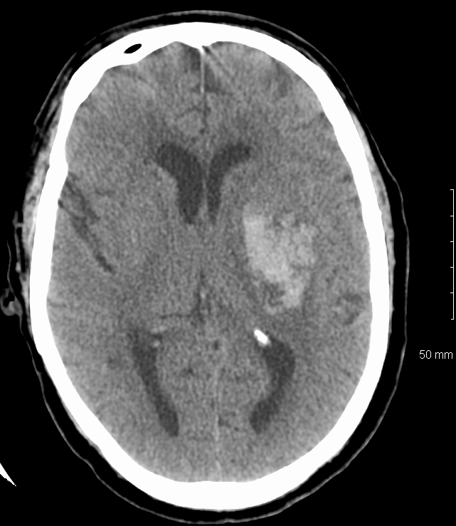
Who Is at Risk of Expansion?
Imaging
Noncontrast CT
CT angiography
Demographics
Labs
Medications
Image courtesy of Opeolu Adeoye, MD, MS

Slide 5
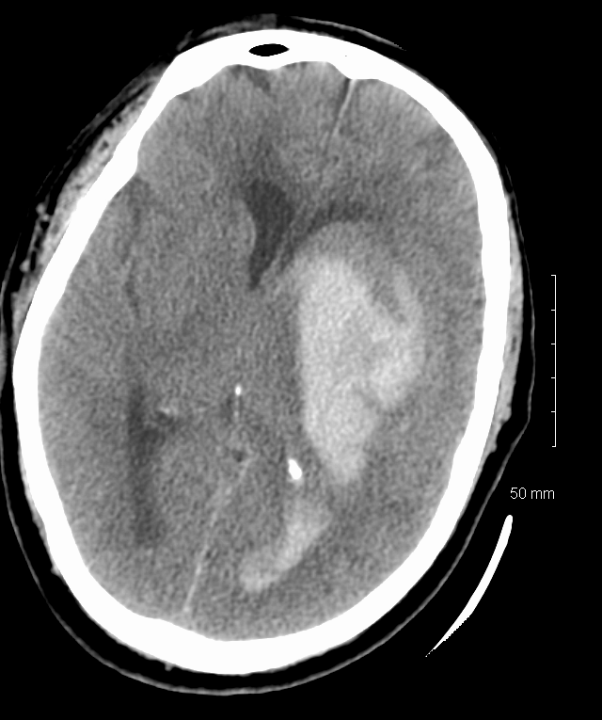
Hemorrhage Expansion
Images courtesy of Opeolu Adeoye, MD, MS, Washington University

Slide 6
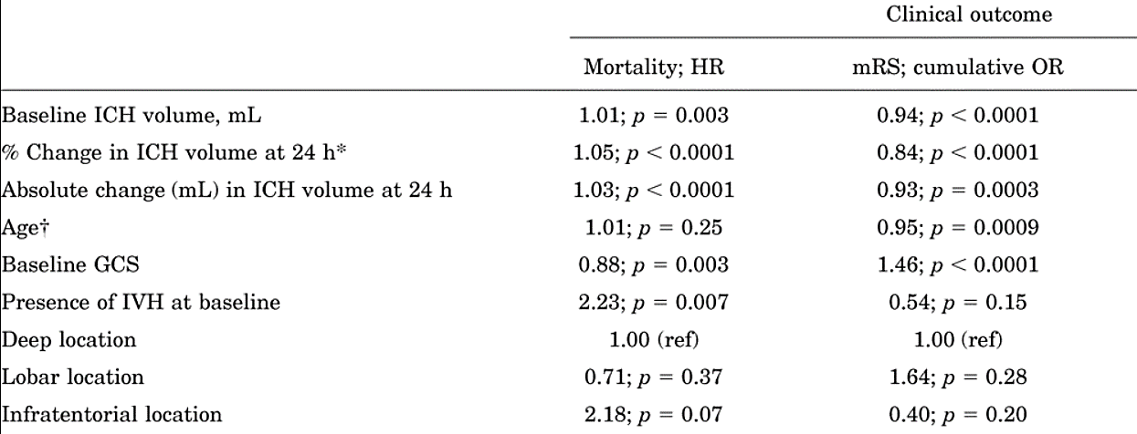
Hematoma Expansion Impacts Outcomes

Slide 7
ICH Timing of Anticoagulation Reversal VKA
Emergency medicine physicians must be comfortable with anticoagulation reversal
Significantly lower rate of hematoma enlargement when INR reversed to less than 1.3 and systolic BP less than 60 mmHg within 4 hours (18.1% versus 44.2%)

Slide 8
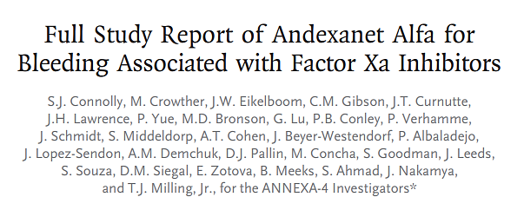

Slide 9
Hematoma Expansion Propensity Matched Real-World Data

Slide 10
Hematoma Expansion in ICH, Clinical Trial Versus Real-World Management

Slide 11
Ongoing Work

