Slide 1
ANNEXa-I: Recent Advances in the Treatment of Intracranial Hemorrhage (ICH)
Natalie Kreitzer, MD, MS
Associate Professor of Emergency Medicine and Neurocritical Care
University of Cincinnati
Cincinnati, OH

Slide 2
Resource Information
About This Resource
These slides are one component of a continuing education program available online at MedEd On The Go titled The Life-Threatening Bleeding in the Anticoagulated Patient Journal Club: Real World Evidence for Effectiveness
Program Learning Objectives:
Evaluate recent practice-changing data that can be applied to practice in the presence of a life-threatening bleed in the presence of anticoagulation
Apply the latest evidence-based approaches to maximize management prognostic outcomes for life-threatening bleeds in the presence of anticoagulation
MedEd On The Go®
www.mededonthego.com
This content or portions thereof may not be published, posted online or used in presentations without permission.
This content can be saved for personal use (non-commercial use only) with credit given to the resource authors.
To contact us regarding inaccuracies, omissions or permissions please email us at support@MedEdOTG.com

Slide 3
Disclaimer
The views and opinions expressed in this educational activity are those of the faculty and do not necessarily represent the views of Total CME, LLC, the CME providers, or the companies providing educational grants. This presentation is not intended to define an exclusive course of patient management; the participant should use their clinical judgment, knowledge, experience, and diagnostic skills in applying or adopting for professional use any of the information provided herein. Any procedures, medications, or other courses of diagnosis or treatment discussed or suggested in this activity should not be used by clinicians without evaluation of their patient's conditions and possible contraindications or dangers in use, review of any applicable manufacturer’s product information, and comparison with recommendations of other authorities. Links to other sites may be provided as additional sources of information.

Slide 4
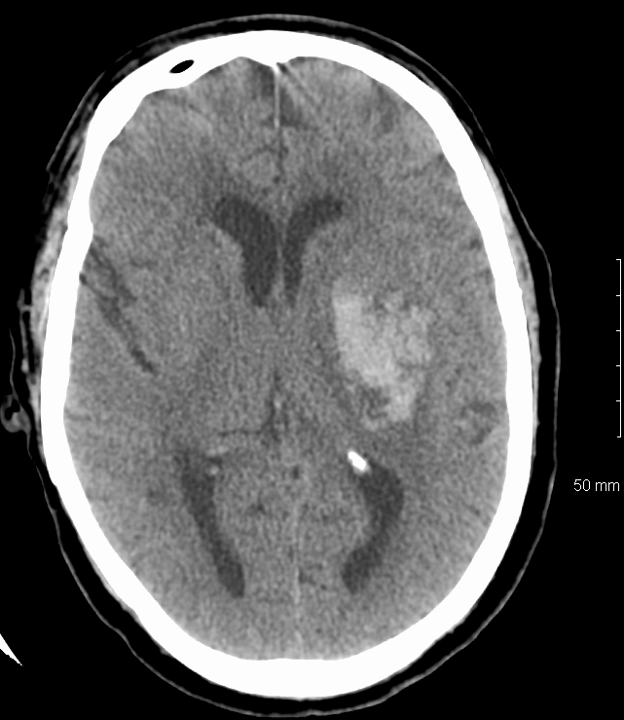
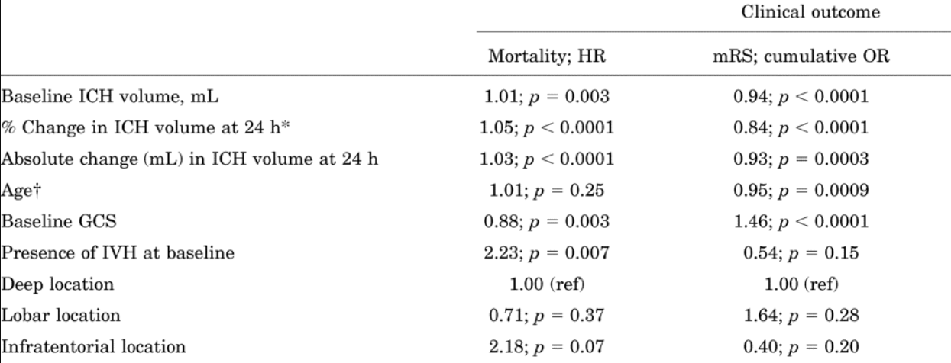
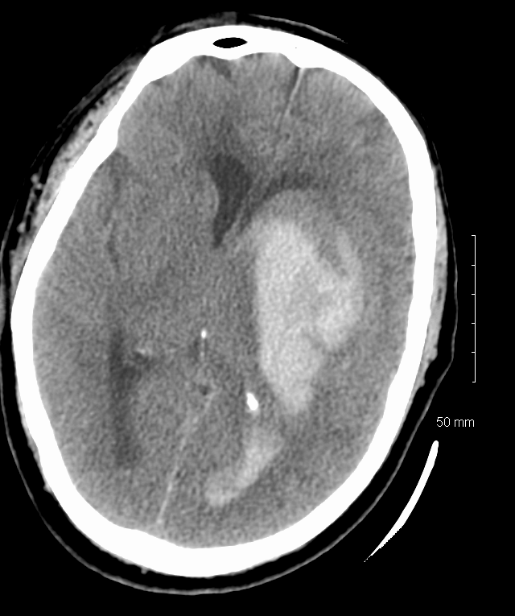
ANNEXa-I : A Phase 4 Study of Andexanet Alfa in Acute Intracranial Hemorrhage in Patients Receiving an Oral Factor Xa Inhibitor - Background
Hematoma expansion is a critical target of treatment in ICH

Slide 5
ANNEXa-I Methods
Baseline Scan, Labs, and Clinical Assessments
Efficacy and Safety Assessments
Safety Follow-up
Patient Screening
Randomization
Adult patients with acute ICrH within 6 hours of symptom onset and within 15 hrs of taking an oral Fxa inhibitor (apixaban, and edoxaban)
Andexanet affa
-2 hr
0 hr
1 hr
2 hrs
3 hrs
6 hrs
12 hrs
24 hrs
72 hrs
30 days
Usual care
Treatment Window

Slide 6
Inclusion and Exclusion
≥18 years, informed consent
≥0.5 mL to ≤60 mL ICH
Imaging within 2 hours prior to randomization
Treatment with an oral FXa inhibitor within 15 hours, or anti FXa activity of 100 ng/mL
A NIHSS score ≤ 35
LSW < 6 hours prior to first imaging
Non pregnant, non lactating
Planned surgery within 12 hours
GCS < 7
TE event within 2 weeks
Not expected to survive 1 month
Recipient of blood product or reversal agent in 7 days prior
Treatment with another IP
Tumor-related bleeding
Past/present use of AA
Know hypersensitivity/allergy to AA

Slide 7
Primary Endpoint: Effective Hemostasis
Hematoma expansion of ≤20% (excellent) or ≤35% (good) at 12 hours, and
Change in NIHSS score and
No rescue therapy administered 3- to 12-hours post-randomization

Slide 8
Secondary Endpoints
Percent change from baseline to nadir in anti-FXa activity during the first 2 hours post-randomization
Change in endogenous thrombin potential (ETP) from baseline to 1 hour and 12 hours post-randomization
Neurological deterioration defined using the NIHSS (>4-point increase) and GCS score (>2-point decrease)
mRS score at 30 days
Proportion of patients receiving rescue therapy
Hemostatic efficacy assessed using imaging parameters
Correlation between anti-FXa activity and achievement of effective hemostasis
HRQoL (based on EQ-5D questionnaire) at 30 days

Slide 9
Safety Endpoints
Occurrence of TEs and mortality through 30 days post-randomization
AEs and vital signs
In-hospital and 30-day mortality (all-cause, CV, and bleeding)
Hospital LOS for primary bleeding event
ICU stay during initial hospitalization
Re-hospitalizations at 30 days post-randomization
Performance of invasive intracranial procedures to manage ICrH
Antibodies to andexanet alfa, native factor X or FXa

Slide 10
Baseline Characteristics

Slide 11
Primary Endpoint

Slide 12
Additional Endpoints
Change in Anti- FXa Activity
 | Andexanet alfa (N=263) n (%) | Usual Care (N=267) n (%) | Reduction in anti-FXa activity with andexanet alfa (%), median (IQR)ª
Patients on apixaban | 162 (61.6) | 158 (59.2) | 94.0 (96.4-88.8)
Patients on Rivaroxaban | 79 (30.0) | 75 (28.1) | 96.4 (97.9-93.2)
Patients on edoxaban | 22 (8.4) | 31 (11.6) | 72.3 (78.9-37.4)
Hematoma Volume and mRS score
 | Andexanet alfa (N=263) n (%) | Usual care (N=267) n (%) | Absolute difference with andexanet alfa (95% CI)
Hematoma increase ≥12.5, mL | 29 (11.6) | 48 (19.0) | -7.4 (-13.7 to -1.1)
mRS score ≤3 at 30 days | 69 (28.0) | 79 (30.9) | -2.9 (-10.9 to 5.2)ª

Slide 13
Safety Endpoints

Slide 14
Summary of Initial Results
Patients with ICH warrant early and aggressive management due to high risk of neurological impairment and mortality
ANNEXa-I is the only RCT of AA versus usual care in patients with FXa inhibitor-related ICH
Achievement of effective hemostasis was significantly higher in patients treated with andexanet alfa versus usual care
Andexanet alfa is the only FDA-approved specific reversal agent for apixaban or rivaroxaban in patients with FXa inhibitor-related life-threatening or uncontrolled bleeding

Slide 15
Looking for more resources on this topic?
CME/CE in minutes
Congress highlights
Late-breaking data
Quizzes
Webinars
In-person events
Slides & resources
www.MedEdOTG.com

