Slide 1
GI Bleeding and DOACs: Consensus Panel Findings
Gregory J. Fermann, MD
Professor and Executive Vice Chairman
Department of Emergency Medicine
University of Cincinnati College of Medicine
Cincinnati, OH

Slide 2
Resource Information
About This Resource
These slides are one component of a continuing education program available online at MedEd On The Go titled The Life-Threatening Bleeding in the Anticoagulated Patient Journal Club: Real World Evidence for Effectiveness
Program Learning Objectives:
Evaluate recent practice-changing data that can be applied to practice in the presence of a life-threatening bleed in the presence of anticoagulation
Apply the latest evidence-based approaches to maximize management prognostic outcomes for life-threatening bleeds in the presence of anticoagulation
MedEd On The Go®
www.mededonthego.com
This content or portions thereof may not be published, posted online or used in presentations without permission.
This content can be saved for personal use (non-commercial use only) with credit given to the resource authors.
To contact us regarding inaccuracies, omissions or permissions please email us at support@MedEdOTG.com

Slide 3
Disclaimer
The views and opinions expressed in this educational activity are those of the faculty and do not necessarily represent the views of Total CME, LLC, the CME providers, or the companies providing educational grants. This presentation is not intended to define an exclusive course of patient management; the participant should use their clinical judgment, knowledge, experience, and diagnostic skills in applying or adopting for professional use any of the information provided herein. Any procedures, medications, or other courses of diagnosis or treatment discussed or suggested in this activity should not be used by clinicians without evaluation of their patient's conditions and possible contraindications or dangers in use, review of any applicable manufacturer’s product information, and comparison with recommendations of other authorities. Links to other sites may be provided as additional sources of information.

Slide 5
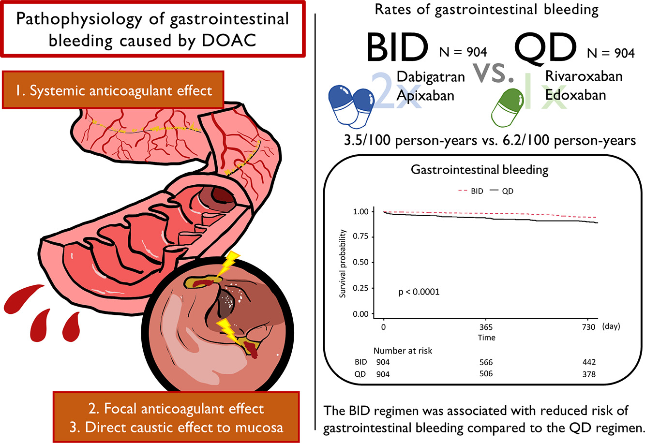
Major GI Hemorrhage in DOAC Era
Most common complication
Maybe more common with DOACs dosed QD vs BID
Focal anticoagulant effect
Direct caustic effect on mucosa
Systemic anticoagulant effect

Slide 6
Methods: Study Design
Multicenter, observational cohort study*
ClinicalTrials.gov Identifier: NCT05548777
Inclusion Criteria
STUDY TYPE
Age ≥18 years
Hospitalized for anticoagulant-related major bleed†
Rivaroxaban or apixaban use at time of bleeding event
Treatment with either andexanet alfa or 4F-PCC during hospitalization
Documented discharge disposition
EHRs from
354 US hospitals
DATA SOURCE
Discharge dates
May 2018 to September 2022
TIMING

Slide 7
Results: Overall Population – Patient and Treatment Characteristics
Characteristics for andexanet alfa (N = 2122) versus 4F-PCC (N = 2273)¹
Variable | Andexanet alfa | 4F-PCC
Age, years, mean | 65.6 | 66.6
Male, % | 57.2 | 60.5
Alteration in mental status, %* | 33.2 | 37.1
DNR order, % | 18.3 | 19.8
Comorbidities, %
Diabetes | 42.9 | 44.0
Heart failure | 23.1 | 22.4
CKD | 22.9 | 23.2
Liver disease | 12.3 | 13.0
Time from last FXai dose, to hospital admission, %†
<8 hours | 44.1 | 41.5
8-18 hours | 41.8 | 41.1
>18 hours | 14.0 | 17.4
Door-to-administration time, hours, median | 2.5 | 2.3
Bleed Locations
Andexanet alfa
4F-PCC
1.8%
1.8%
10.0%
9.2%
56.8%
29.1%
59.9%
31.4%
GI
ICH
Critical compartment/
noncompressible
Other

Slide 8
GI Bleed Subgroup: Patient Characteristics
Andexanet alfa (n = 1,206) versus 4F-PCC (n = 1,361)
Mean
 | Andexanet alfa | 4F-PCC
Location of presentation, %*
Emergency department | 82.7 | 84.1
Directly admitted | 8.5 | 5.9
Hospital transfer | 8.6 | 9.8
Comorbidities, %†
Hypertension | 61.9 | 60.0
Diabetes | 44.8 | 42.2
Heart failure | 22.8 | 21.9
Chronic kidney disease | 22.0 | 22.1
Impaired mental status | 20.5 | 25.3
Mean
AGE
65.2 vs 65.7
years
56.2% vs 62.0%
AC use, %
Median door to administration time
3.0 vs 2.6
hours
Rivaroxaban
42.5%
Rivaroxaban
35.9%
Last AC dose | Andexanet alfa
<8 h | 42.9% vs 41.2%
8-18 h | 41.6% vs 41.4%
>18 h | 15.5% vs 17.4%
Apixaban
57.5%
Apixaban
64.1%

Slide 9
How Do We Characterize Life-Threatening GI Hemorrhage?
“I know it when I see it?”
Prior recs by ACG/CAG¹ defined major GI hemorrhage:
Shock, severe hypotension
Require pressors or surgery
Decrease in Hgb > 5 g/dl
Transfuse > 5 U PRBCs
Death
ISTH definition of major hemorrhage
Delphi technique consensus panel
Focus on definition of GIB in context of DOAC era and availability of reversal agent(s)
Multidisciplinary group (US/EU)
Review NICE guidance²

Slide 10
Consensus Panel

Slide 11
Summary
Hemorrhage is the most common adverse event associated with DOAC use
Major GI hemorrhage is the most common reason for reversal agent use
Hemodynamic collapse (signs of shock) PLUS individual patient characteristics should be considered when deciding to use reversal agents
Comorbid conditions especially CKD, HF, and malignancy contribute to decision to use reversal agents
If used – there appears to be a consensus that there is a time to treatment effect

Slide 12
Looking for more resources on this topic?
CME/CE in minutes
Congress highlights
Late-breaking data
Quizzes
Webinars
In-person events
Slides & resources
www.MedEdOTG.com

