Slide 1
Summary of Real-World Data for Treatment of Oral Factor Xa-Related Major Bleeding
Paul P. Dobesh, Pharm. D. FACC, FAHA, FCCP, BCPS, BCCP
Professor of Pharmacy Practice and Science
College of Pharmacy
University of Nebraska Medical Center
Omaha, Nebraska

Slide 2
Resource Information
About This Resource
These slides are one component of a continuing education program available online at MedEd On The Go titled The Life-Threatening Bleeding in the Anticoagulated Patient Journal Club: Real World Evidence for Effectiveness
Program Learning Objectives:
Evaluate recent practice-changing data that can be applied to practice in the presence of a life-threatening bleed in the presence of anticoagulation
Apply the latest evidence-based approaches to maximize management prognostic outcomes for life-threatening bleeds in the presence of anticoagulation
MedEd On The Go®
www.mededonthego.com
This content or portions thereof may not be published, posted online or used in presentations without permission.
This content can be saved for personal use (non-commercial use only) with credit given to the resource authors.
To contact us regarding inaccuracies, omissions or permissions please email us at support@MedEdOTG.com

Slide 3
Disclaimer
The views and opinions expressed in this educational activity are those of the faculty and do not necessarily represent the views of Total CME, LLC, the CME providers, or the companies providing educational grants. This presentation is not intended to define an exclusive course of patient management; the participant should use their clinical judgment, knowledge, experience, and diagnostic skills in applying or adopting for professional use any of the information provided herein. Any procedures, medications, or other courses of diagnosis or treatment discussed or suggested in this activity should not be used by clinicians without evaluation of their patient's conditions and possible contraindications or dangers in use, review of any applicable manufacturer’s product information, and comparison with recommendations of other authorities. Links to other sites may be provided as additional sources of information.

Slide 4
FIX ICH Study: Retrospective Analysis of PCC for Xa Inhibitor Reversal
Patient Characteristics
Primary End Points
Primary Intracranial Site
Intracerebral | 39.7%
Subarachnoid | 15.7%
Subdural | 44.6%
Multiple | 23.8%
Hemostatic Efficacy at 24 hours (n=433)
Overall | 81.8%
Intracerebral | 73.3%
Subarachnoid | 85.3%
Subdural | 88.1%
aPCC | 88.1%
4F-PCC | 79.4%
Anticoagulant
Apixaban | 54%
Rivaroxaban | 46%
Thrombotic Events (n=663)
Overall (n=25) | 3.8%
PCC Administered
aPCC | 27.3%
4F-PCC | 72.7%

Slide 5
FIX ICH Study: Retrospective Analysis of PCC for Xa Inhibitor Reversal
Patient Characteristics
Timing of first brain scan not reported
Excluded patients with intraventricular involvement or epidural hematoma
Time from last dose of DOAC not collected
Only 24% discharged home
Primary End Points
Primary Intracranial Site
Intracerebral | 39.7%
Subarachnoid | 15.7%
Subdural | 44.6%
Multiple | 23.8%
Hemostatic Efficacy at 24 hours (n=433)
Overall | 81.8%
Intracerebral | 73.3%
Subarachnoid | 85.3%
Subdural | 88.1%
aPCC | 88.1%
4F-PCC | 79.4%
Anticoagulant
Apixaban | 54%
Rivaroxaban | 46%
Thrombotic Events (n=663)
Overall (n=25) | 3.8%
PCC Administered
aPCC | 27.3%
4F-PCC | 72.7%

Slide 6
Observational Prospective Studies of 4F-PCC for DOAC-Associated Major Bleeding
Study | Majeed 2017 (n=84) | Schulman 2018 (n=66) | Bavalia 2020 (n=51)
Reversal agent | Median 4F-PCC dose 2000 units (1500-2000 units); 25 units/kg | 4F-PCC fixed 2000 units | Median 4F-PCC dose 3500 units (3000-4000 units); 50 units/kg
Agent reversed | Apixaban (46.4%) Rivaroxaban (53.6%) | Apixaban (44%) Rivaroxaban (56%) | Apixaban (46%) Rivaroxaban (54%)
ICH | 70% | 55% | 59% (45/76)
Time since last dose (h) | 12.5 (9-16) | 18 (12-21) | 10 (6-16)
Effective hemostasis at 24 hours | Effective = 69.1% | Overall = 85%: Good = 65%; Moderate = 20% | Effective = 70% (17% levels <50 ng/mL)
Thrombotic events | 4% | 8% | 2%
30-day mortality | 32% | 14% | 18%

Slide 7
4F-PCC Versus Andexanet Alfa for ICH
Study | Barra 2020 (n=29) | Ammar 2021 (n=44) | Pham 2022 (n=109)
Study design | Retrospective single center | Retrospective single center | Retrospective health system
Reversal agents | Andexanet alfa (n=18) vs. 4F-PCC (n=11) | Andexanet alfa (n=28) vs. 4F-PCC (n=16) | Andexanet alfa (n=47) vs. 4F-PCC (n=62)
Effective hemostasis at 24 hours | Good/effective: 89% andexanet alfa vs. 60% 4F-PCC | Stable head CT at 6 post dose: 78% andexanet alfa vs. 71% 4F-PCC 24 hours = 88% vs. 60% | Excellent: 71% andexanet alfa vs. 71% 4F-PCC
Thrombotic events | 16.7% andexanet alfa vs. 9.1% 4F-PCC | 7% andexanet alfa vs. 0% 4F-PCC | 8.5% andexanet alfa vs. 9.7% 4F-PCC
Mortality | In-hospital mortality: 22% andexanet alfa vs. 64% 4F-PCC | Death or hospice at discharge: 39% andexanet alfa vs. 38% 4F-PCC | In-hospital mortality: 34% andexanet alfa vs. 21% 4F-PCC

Slide 8
Limitations of 4F-PCC Studies for DOAC Reversal
Small single center or single system studies with high risk of type 2 error due to lack of power
Limited, it any, statistical adjustments for differences between groups.
Unclear definitions and lack of adjudication of index bleeding event and outcomes
Variable use of accepted definitions for hemostasis (clinical judgement was used)
Inconsistent follow-up time to assess outcomes
In-hospital versus 30-day mortality
In-hospital versus 30-day thrombotic events
Hemostatic efficacy at 12 or 24 hours
Inconsistent reporting of time from last dose of DOAC to 4F-PCC administration
Typically not reported

Slide 9
Multicenter Study: Real-World Management of Oral Factor Xa Inhibitor Bleeding
Electronic health records study from 45 US hospitals were queried using ICD-10-CM billing codes to identify major bleeding hospitalizations related to oral factor Xa inhibitor use
 | Andexanet alfa (n=342) | 4F-PCC (n=733) | FFP (n=925) | All Other Agents (n=974)
Patients presenting with GI bleeding | 40% | 41% | 50% | 53%
Patients presenting with ICH | 20% | 23% | 16% | 14%
Patients presenting with critical compartment bleeding | 3% | 29% | 27% | 23%
In-hospital mortality: ICH | 9% | 25% | 27% | 23%
In-hospital mortality: GI bleeding | 1% | 4% | 4% | 4%

Slide 10
ANNEXA-Orange
Study comparing andexanet alfa with 4F-PCC using:
Patients from ANNEXA-4 study who received andexanet alfa
Patients with major bleeding from the prospective ORANGE Registry who received 4F-PCC
410 patients with anticoagulant-related major or life-threatening bleeding
Propensity matching: age, bleeding site, and history of AF, VTE, stroke, renal dysfunction, cancer
Did not match for bleeding severity, volume of bleeding
322 patients who received andexanet alfa within the ANNEXA-4 trial
88 patients who received 4F-PCC within the ORANGE prospective registry for DOAC reversal
Mean age: 78 years (ANNEXA-4 trial)—75 years (4F-PCC)
Bleeding events:
Life-threatening ICH (65% andexanet alfa and 67% 4F-PCC)
GI bleeding (25% andexanet alfa and 29% 4F-PCC)

Slide 11
ANNEXA-Orange: Results
Population | Andexanet Alfa Mortality (%) | PCC Mortality (%) | Absolute % Reduction | p-value
Whole population (N = 410) | 14.6 | 34.1 | 19.5 | <0.001
ICH subgroup (n = 256) | 15.3 | 48.9 | 33.6 | <0.001
GI bleeding subgroup (n = 110) | 12.2 | 25.0 | 12.8 | 0.11

Slide 12
Real-World Study in US Veterans Andexanet Alfa Versus 4F-PCC
Patients with factor Xa major bleeding between 3/2014 and 12/2020 (n=255)
Andexanet alfa (n=85)
4F-PCC (n=170)
Data from the Veterans Affairs Informatics and Computing Infrastructure (VINCI)
Propensity score-weighted Cox Model
Andexanet alfa was associated with a 69% lower hazard of in-hospital mortality compared to 4F-PCC (HR 0.31, 95% CI 0.14-0.71)
Andexanet alfa was associated with a 46% lower hazard of 30-day mortality compared to 4F-PCC (HR 0.54, 95% CI 0.30-0.98)
p=0.04
p=0.01

Slide 13
Largest Real-World Evaluation to Date
A multicenter observational study was conducted in patients (N = 4,395) hospitalized with rivaroxaban- or apixaban-associated major bleeding and treated with either andexanet alfa or 4F-PCC
The study captured data extracted from EHRs in 354 US institutions/hospitals across 42 states
Primary outcome: in-hospital mortality
Multivariable logistic regression was used to compare odds of in-hospital mortality with andexanet alfa versus 4F-PCC

Slide 14
Overall Population – In-Hospital Mortality
Multivariable logistic regression
adjusted OR: 0.50 (95% CI: 0.39, 0.65); P <0.01
Adjusted odds of
in-hospital mortality were 50% lower for patients treated with andexanet alfa versus 4F-PCC
10.6%
In-hospital mortality
(unadjusted %)
6.0%

Slide 15
ICH Subgroup – In-Hospital Mortality
Multivariable logistic regression
adjusted OR: 0.55 (95% CI: 0.39, 0.76); P <0.01
23.3%
Adjusted odds of in-hospital mortality were
45% lower
for patients with ICH
treated with
andexanet alfa versus 4F-PCC
In-hospital mortality
(unadjusted %)
12.6%

Slide 16
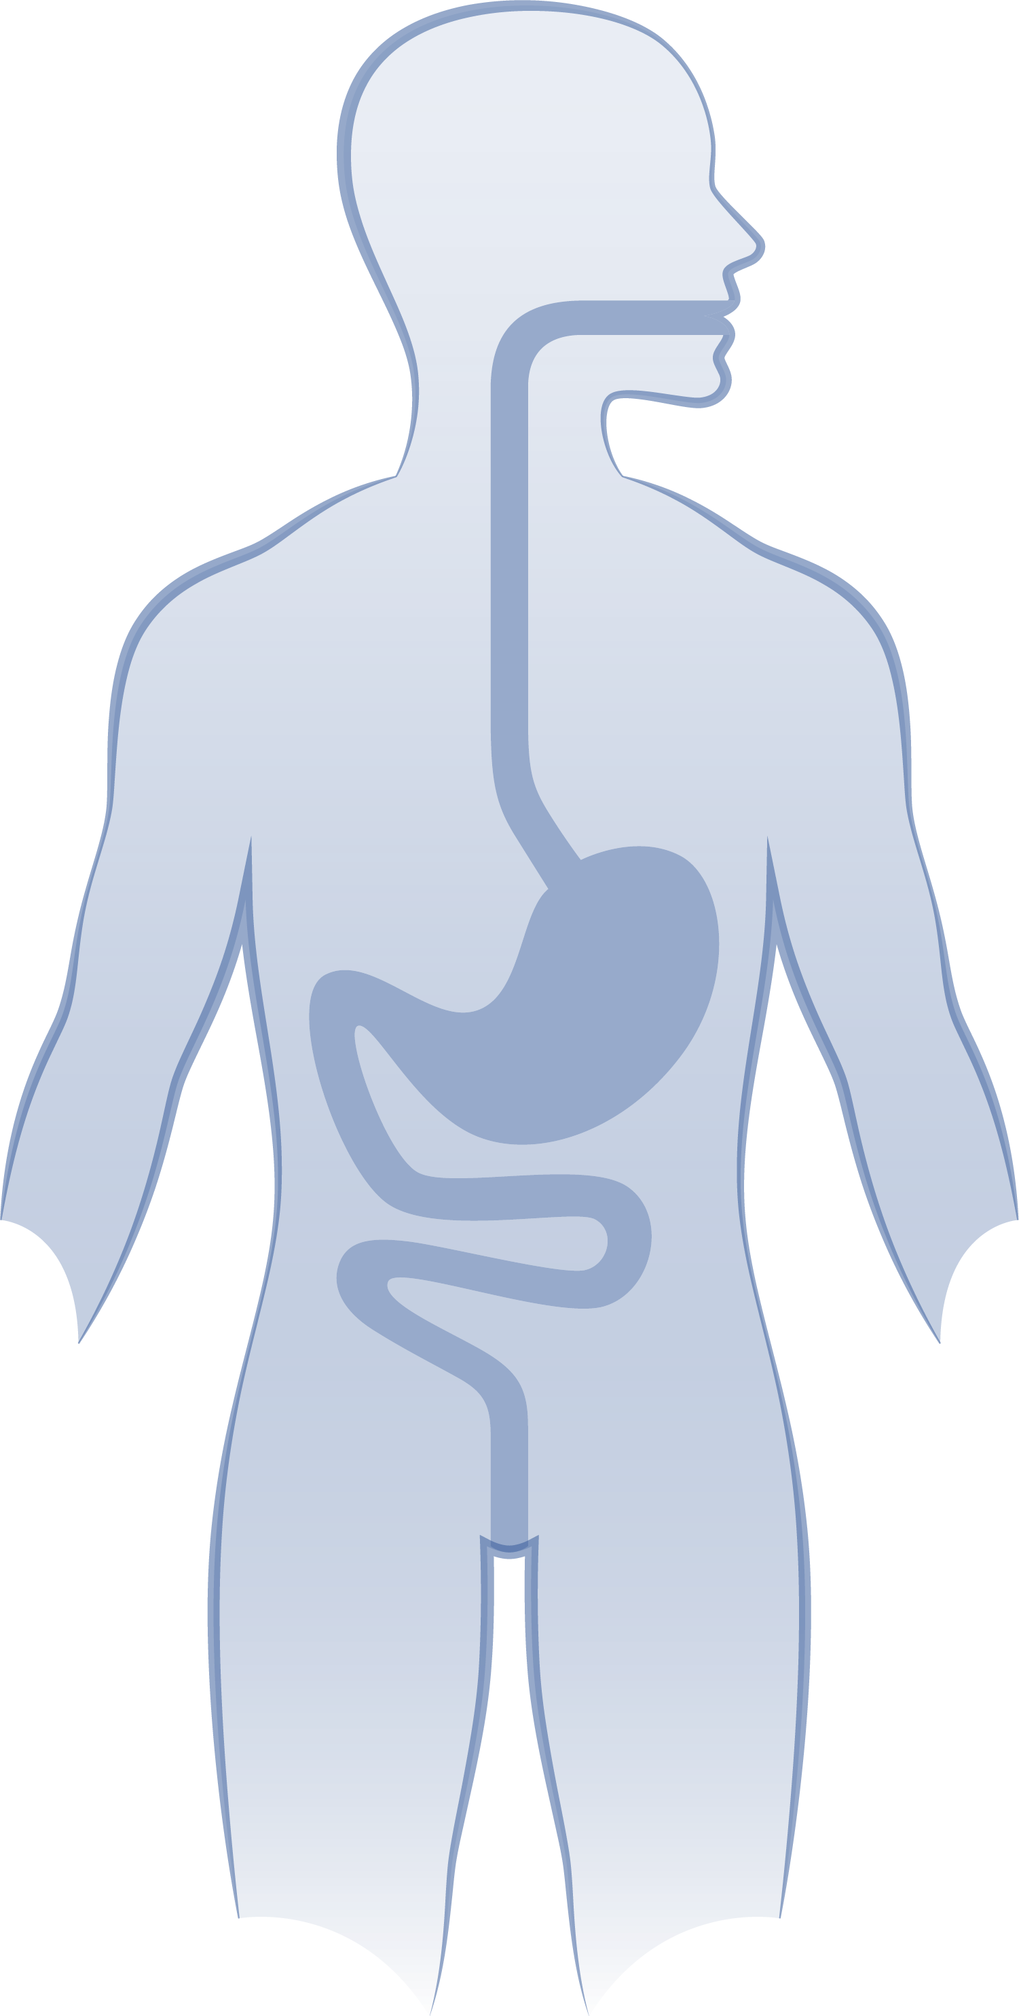
GI Bleed Subgroup – In-Hospital Mortality
Multivariable logistic regression
adjusted OR: 0.49 (95% CI: 0.29, 0.81); P = 0.01
Adjusted odds of in-hospital mortality were
51% lower
for patients with GI bleeds treated with
andexanet alfa versus 4F-PCC
In-hospital mortality
(unadjusted %)
4.3%
2.5%

Slide 17
Summary
Real-world data is commentary to prospective clinical trials
Confirmatory
Answer questions not achievable in available prospective clinical trials
Initial real-world evidence suggesting similar outcomes between andexanet alfa and 4F-PCC were plagued by several limitations
Small size and scope
No time from last dose
No statistical adjustments for differences between groups
Inconsistent outcome evaluations
More recent well-designed real-world comparisons consistently demonstrate a significantly lower in-hospital and 30-day mortality of approximately 50%

Slide 18
Looking for more resources on this topic?
CME/CE in minutes
Congress highlights
Late-breaking data
Quizzes
Webinars
In-person events
Slides & resources
www.MedEdOTG.com

