Slide 1
Current Guidelines and Real-World Evidence for ROS1 Testing in NSCLC
Charu Aggarwal, MD, MPH, FASCO
Associate Director
University of Pennsylvania
Philadelphia, PA

Slide 2



Resource Information
About This Resource
These slides are one component of a continuing education program available online at MedEd On The Go titled Next-Generation TKI Therapy for ROS1-Rearranged NSCLC
Program Learning Objectives:
Discuss current guidelines and standards for molecular testing in real-world practice settings.
Assess the latest evidence of approved ROS1 inhibitors and emerging next-generation TKIs for the treatment of newly diagnosed ROS1-rearranged NSCLC.
Analyze treatment options for patients with ROS1-rearranged, advanced NSCLC in second- or subsequent-line therapy focused on acquired resistance mutations and CNS involvement.
Evaluate intracranial penetration and activity against acquired resistance mutations seen with ROS1-targeted TKI therapies
Evaluate the toxicity profiles of current and emerging ROS1 TKI agents and to inform optimal strategies for preventing and mitigating TKI-related adverse events
MedEd On The Go®
www.mededonthego.com
This content or portions thereof may not be published, posted online or used in presentations without permission.
This content can be saved for personal use (non-commercial use only) with credit given to the resource authors.
To contact us regarding inaccuracies, omissions or permissions please email us at support@MedEdOTG.com

Slide 3
Disclaimer
The views and opinions expressed in this educational activity are those of the faculty and do not necessarily represent the views of Total CME, LLC, the CME providers, or the companies providing educational grants. This presentation is not intended to define an exclusive course of patient management; the participant should use their clinical judgment, knowledge, experience, and diagnostic skills in applying or adopting for professional use any of the information provided herein. Any procedures, medications, or other courses of diagnosis or treatment discussed or suggested in this activity should not be used by clinicians without evaluation of their patient's conditions and possible contraindications or dangers in use, review of any applicable manufacturer’s product information, and comparison with recommendations of other authorities. Links to other sites may be provided as additional sources of information.

Slide 4
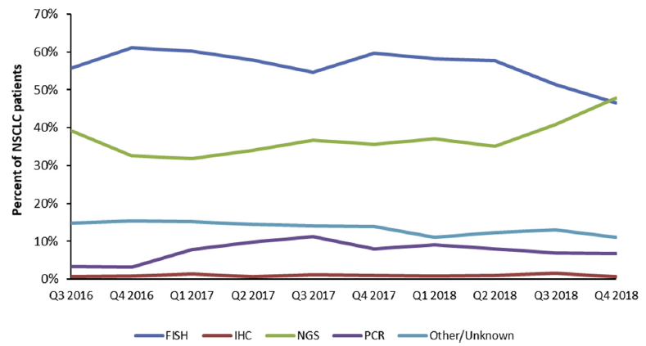
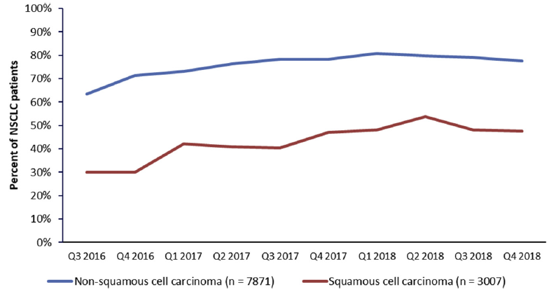
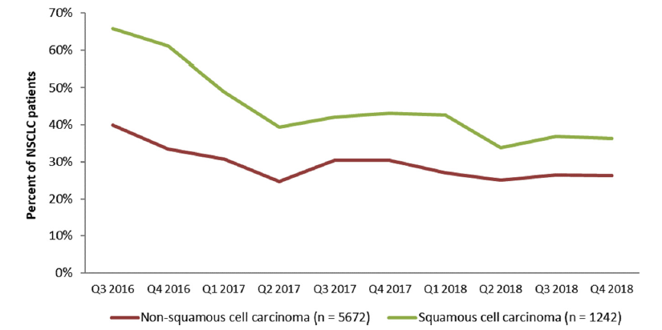
ROS1 Testing Rates in U.S. Community Oncology Practices
Type of ROS1 Testing Received*
Percent of Patients Tested
* Patients could receive ≥1 ROS1 test
Initiation of Therapy Before ROS1 Test Result

Slide 5
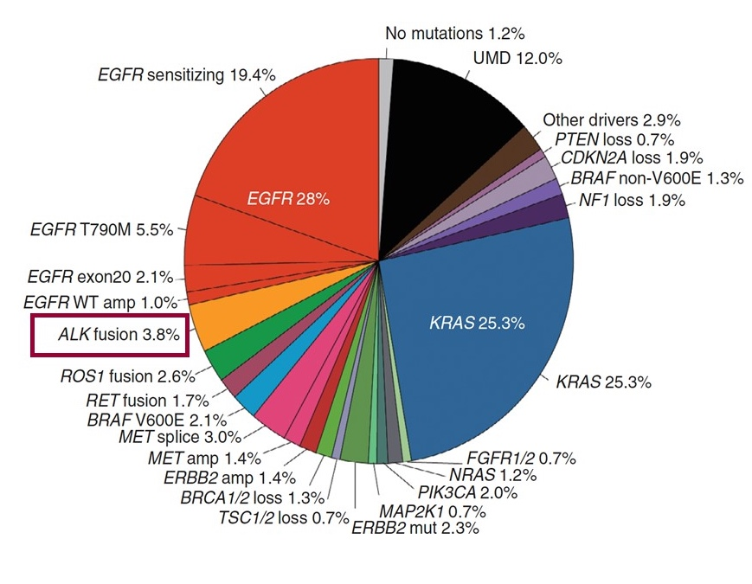
ROS1- Rearranged NSCLC – Testing
Currently recommended^{1,2}* for all non-squamous NSCLC patients with metastatic disease
FISH Break Apart Probe – may under detect
FIG-ROS1 variant
IHC for ROS1 – low specificity (follow up confirmation necessary)
NGS assays (need to consider using RNA fusion panels)
Targeted PCR (may miss novel partners)
N=860, identified by MSK-IMPACT³

Slide 6
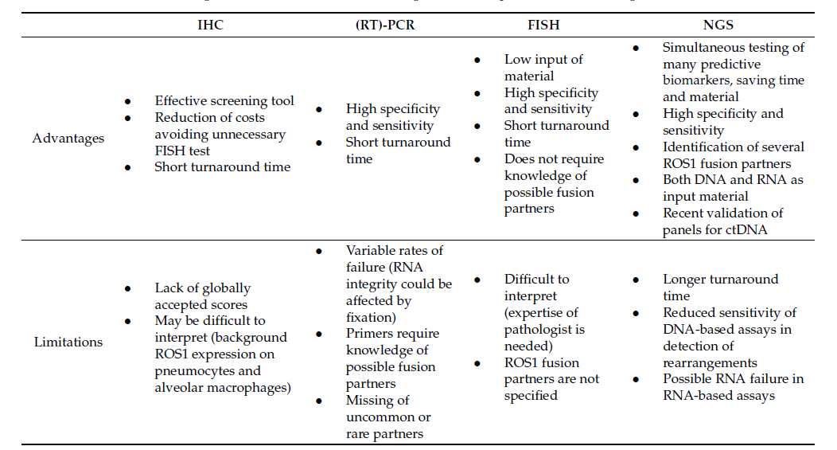
Advantages and Limitations of Diagnostic Techniques for ROS1 Rearrangement Detection

Slide 7
TKI Therapies for ROS1- Rearranged NSCLC
ROS1 TKI | Study (phase) | Overall outcomes |  |  |  | Intracranial outcomes
 |  | OOR (n) | Median DoR | Median PFS | Median OS | ORR (n) | Other
ROS1 TKI-native setting
Crizotinib | PROFILE 1001¹(lb) | 72% (38/53) | 24.7 months | 19.3 months | 51.4 months | – | –
 | OxOnc²(ll) | 72% (91/127) | 19.7 months | 15.9 months | – | – | –
 | EUCROSS³(ll) | 70% (21/30) | 19.0 months | 20.0 months | – | – | –
 | AcSe⁴(ll) | 69% (25/36) | – | 5.5 months | 17.2 months | – | –
 | METROS⁵(ll) | 65% (17/26) | 21.4 months | 22.8 months | – | 33% (2/6) | –
Entrectinib | Drilon et al.⁶(l/ll) | 77% (41/53) | 24.6 months | 19.0 months | – | 55% (11/23) | DoR 12.9 months; PFS 7.7 months
Certinib | Lim et al.⁷(ll) | 67% (20/30) | 21.0 months | 19.3 months | 24.0 months | 29% (2/7) | –
Brigatinib | Takahashi et al.⁸(ll) | 68% (19/28) | – | – | – | – | –
Repotrectinib | Drilon et al.^{9†}(l/ll) | 79% (56/71) | 34.1 months | 35.7 months | NE | 89% (8/9)

Slide 8
Systemic Therapy for ROS1- Rearranged NSCLC
First-Line Therapy
ROS1 rearrangement discovered prior to first-line systemic therapy
Preferred Entrectinib^{a,b} Crizotinibª Repotrectinib^{a,b} Other Recommended Ceritinibª
ROS1 rearrangement discovered during first-line systemic therapy
Complete planned systemic therapy, including maintenance therapy, or Interrupt, followed by Entrectinib^{b} (preferred) Crizotinib (preferred) Repotrectinib^{b} (preferred) or Ceritinib

Slide 9
Subsequent Systemic Therapy for ROS1- Rearranged NSCLC
Progression^{a,b} on entrectinib, crizotinib, repotrectinib, or ceritinib
Asymptomatic
Consider definitive local therapy(e.g, SABR or surgery) for limited lesions^{c,d} Continue first-line TKI or Lorlatinib
Symptomatic Progression
Brain
Consider definitive local therapy(e.g, SABR or surgery) for limited lesions^{d} Entrectinib or repotrectinib (if previously treated with crizotinib or ceritinib) or lorlatinib (if not previously given) Refer to NCCN Guidelines for CNS Cancers
Systemic - Limited
Consider definitive local therapy (e.g., SABR or surgery)^{c} Continue first-line TKI or Therapy for multiple lesions
Systemic – Multiple lesions
Lorlatinib or Systemic therapy options for Adenocarcinoma or Squamous cell carcinoma (refer to guidelines)

Slide 10
Summary
ROS1 fusions represent a therapeutically targetable subset in NSCLC
It is imperative to test for these alterations, so that precision therapy can be utilized to its full extent
Many options exist for first-line therapy, and treatment for progression, including for those patients with CNS disease

Slide 11



Looking for more resources
on this topic?
CME/CE in minutes
Congress highlights
Late-breaking data
Quizzes
Webinars
In-person events
Slides & resources
www.MedEdOTG.com

