Slide 1
Safety and Tolerability of ROS1 Tyrosine Kinase Inhibitors
Alexander Drilon, MD
Chief, Early Drug Development
Memorial Sloan Kettering Cancer Center
New York, NY

Slide 2



Resource Information
About This Resource
These slides are one component of a continuing education program available online at MedEd On The Go titled Next-Generation TKI Therapy for ROS1-Rearranged NSCLC
Program Learning Objectives:
Discuss current guidelines and standards for molecular testing in real-world practice settings.
Assess the latest evidence of approved ROS1 inhibitors and emerging next-generation TKIs for the treatment of newly diagnosed ROS1-rearranged NSCLC.
Analyze treatment options for patients with ROS1-rearranged, advanced NSCLC in second- or subsequent-line therapy focused on acquired resistance mutations and CNS involvement.
Evaluate intracranial penetration and activity against acquired resistance mutations seen with ROS1-targeted TKI therapies
Evaluate the toxicity profiles of current and emerging ROS1 TKI agents and to inform optimal strategies for preventing and mitigating TKI-related adverse events
MedEd On The Go®
www.mededonthego.com
This content or portions thereof may not be published, posted online or used in presentations without permission.
This content can be saved for personal use (non-commercial use only) with credit given to the resource authors.
To contact us regarding inaccuracies, omissions or permissions please email us at support@MedEdOTG.com

Slide 3
Disclaimer
The views and opinions expressed in this educational activity are those of the faculty and do not necessarily represent the views of Total CME, LLC, the CME providers, or the companies providing educational grants. This presentation is not intended to define an exclusive course of patient management; the participant should use their clinical judgment, knowledge, experience, and diagnostic skills in applying or adopting for professional use any of the information provided herein. Any procedures, medications, or other courses of diagnosis or treatment discussed or suggested in this activity should not be used by clinicians without evaluation of their patient's conditions and possible contraindications or dangers in use, review of any applicable manufacturer’s product information, and comparison with recommendations of other authorities. Links to other sites may be provided as additional sources of information.

Slide 4
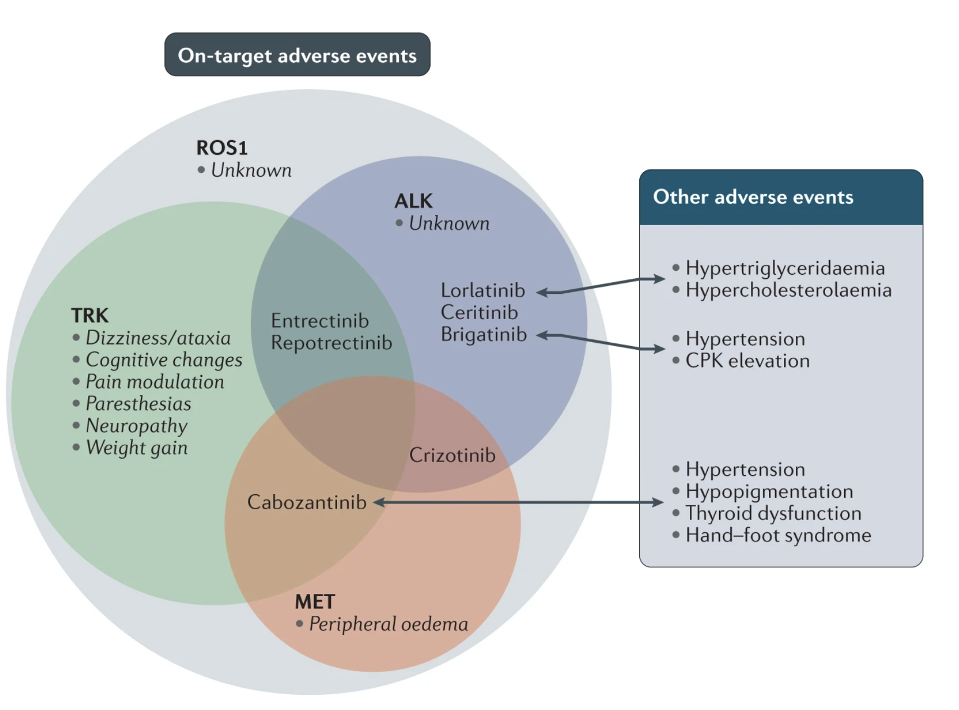
The Side-Effects Patients Experience Are Often Dictated by What Kinases Each Drug Inhibits
(Other ROS1 TKIs like taletrectinib and NVL-520 are not shown)

Slide 5
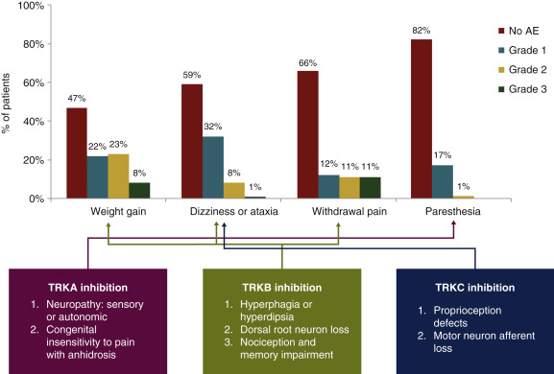
For Entrectinib and Repotrectinib, Watch Out for Side-Effects Mediated by Concurrent TRK Inhibition
Neurologic Adverse Events
N=96

Slide 6
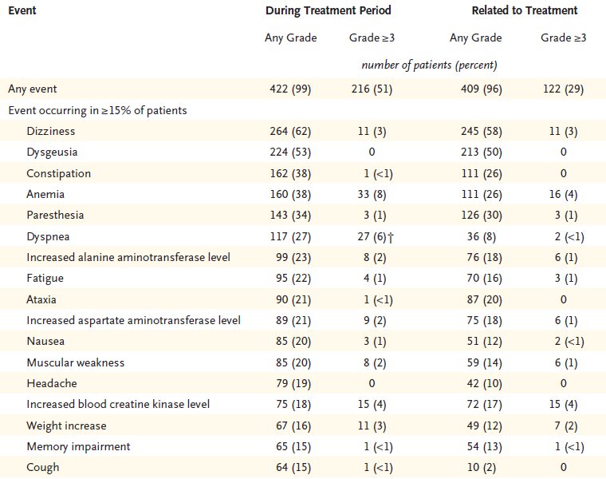
Treatment-Related Adverse Events with Repotrectinib
Dose reduction 38%
Discontinuation rate 7%

Slide 7
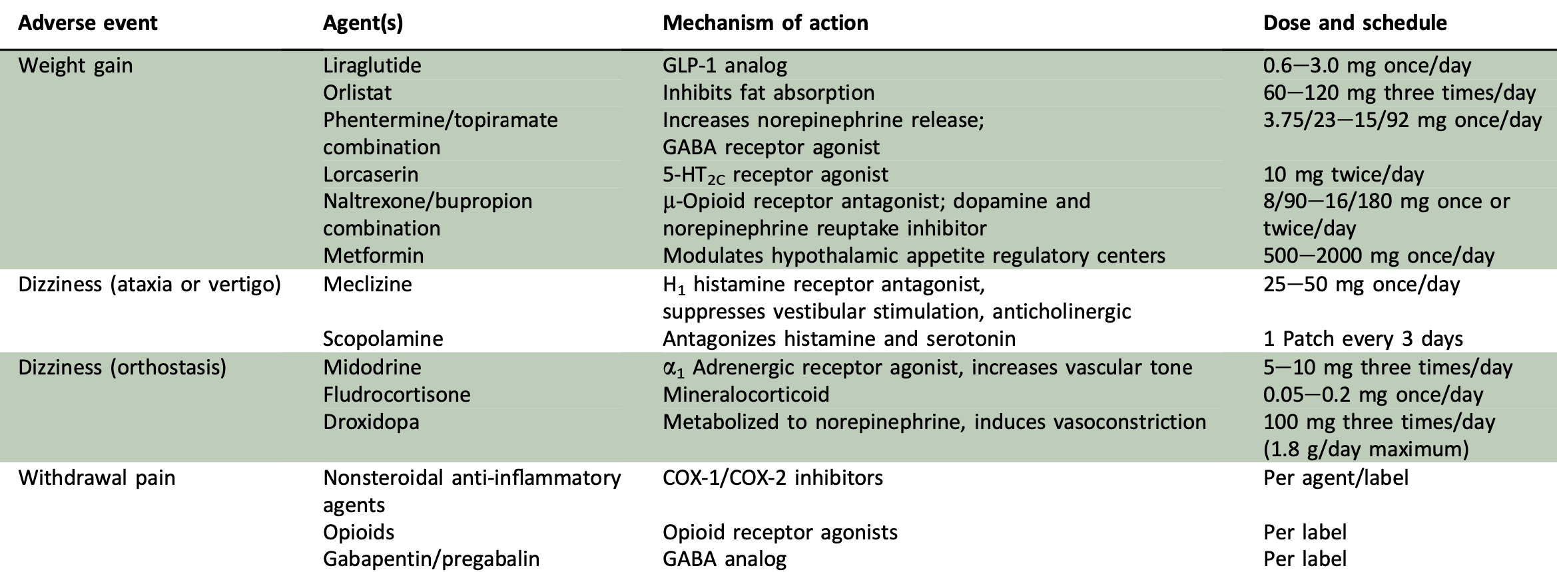
For Entrectinib and Repotrectinib, TRK Inhibition Side-Effects Can Be Managed

Slide 8
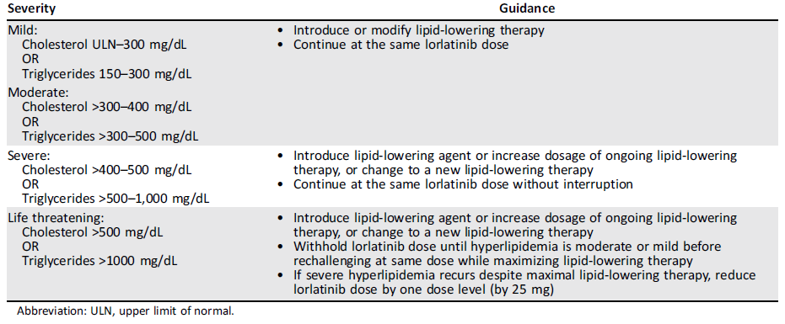
For Lorlatinib, Monitor and Treat Lipid Dysfunction Which Occurs in the Majority of Patients (80+%)

Slide 9
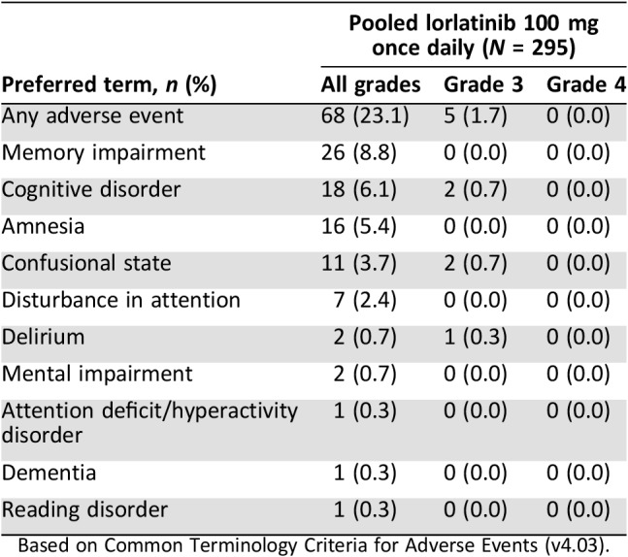
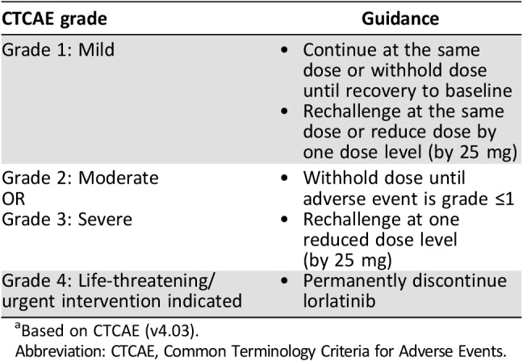
Cognitive Dysfunction and Mood Changes Are Less Common with Lorlatinib

Slide 10
ROS1 TKIs Have Distinct Safety Profiles
 | Notable side-effects
Crizotinib¹ | edema
Ceritinib² | gastrointestinal toxicities
Entrectinib³ | dizziness, paresthesias, weight gain, withdrawal pain
Lorlatinib⁴ | hyperlipidemia, cognitive disorders, mood changes
Repotrectinib⁵ | dizziness, paresthesias, weight gain, withdrawal pain

Slide 11
Summary
ROS1 TKIs can have distinct side-effect profiles
Supportive care and/or dose modification can help mitigate some side-effects

Slide 12



Looking for more resources
on this topic?
CME/CE in minutes
Congress highlights
Late-breaking data
Quizzes
Webinars
In-person events
Slides & resources
www.MedEdOTG.com

